Slide 1
ICS 432 – 01 Distributed and Cloud Computing Fall 2021
Instructor: Thanaa Ghanem
thanaa.ghanem@metrostate.edu
Lecture 4
September 18, 2021

Slide 2
Cloud Storage

Slide 3
Lecture 4: Cloud Storage
Storage in the Cloud
General Concepts about Cloud Storage
Reading:
CCSE Chapter 2: Storage as a service
CompTiA Cloud Essentials+ study Guide: (CESG) Chapter 2: Cloud Networking and Storage. Pages: 57 – 70.
Storage in AWS
AWS Module 7: Storage
Lab exercise 1: Working with Amazon EBS
Lab exercise 2: hosting a static web site on Amazon S3
Reading:
AWS Certified Developer Official Study Guide: (AWSCD) Chapter 3: Hello, Storage Pages 84-112.
Storage in GCP
GCP Module 4: Where do I store this stuff? 4.1, 4.2, 4.3, 4.4, 4.5, and 4.6
Lab exercise 3: Cloud Storage: Qwik Start – Console

Slide 4
Topics
Evolution of Mass Storage in Computing Systems
Direct-Attached Disk (DAS)
Storage-Area Network (SAN)
Network-Attached Storage (NAS)
Software-Defined Storage (SDS)
Cloud Storage
Cloud storage: one tool does not fit all
Data Dimensions
Storage characteristics

Slide 5
Evolution of Mass Storage in computing systems
Disk Drives (HDD and SDD)
Direct-Attached Disk (DAS)
Storage-Area Network (SAN)
Network-Attached Storage (NAS)
Software-Defined Storage (SDS)
Cloud Storage

Slide 6
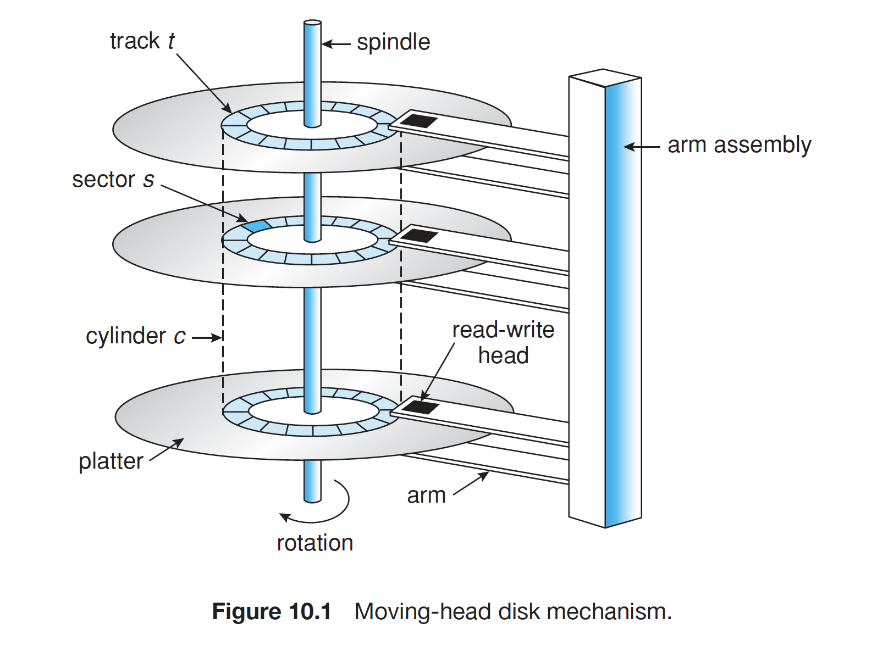
Hard Disk Drives (HDD)
Platters range from .85” to 14” (historically)
Commonly 3.5”, 2.5”, and 1.8”
Range from 30GB to 3TB per drive
Performance
Transfer Rate – theoretical – 6 Gb/sec
Effective Transfer Rate – real – 1Gb/sec
Seek time from 3ms to 12ms – 9ms common for desktop drives
Average seek time measured or calculated based on 1/3 of tracks
Latency based on spindle speed

Slide 7
HDD (continued)
Magnetic disks provide bulk of secondary storage of modern computers
Drives rotate at 60 to 250 times per second
Transfer rate is rate at which data flow between drive and computer
Positioning time (random-access time) is time to move disk arm to desired cylinder (seek time) and time for desired sector to rotate under the disk head (rotational latency)
Head crash results from disk head making contact with the disk surface -- That’s bad

Slide 8
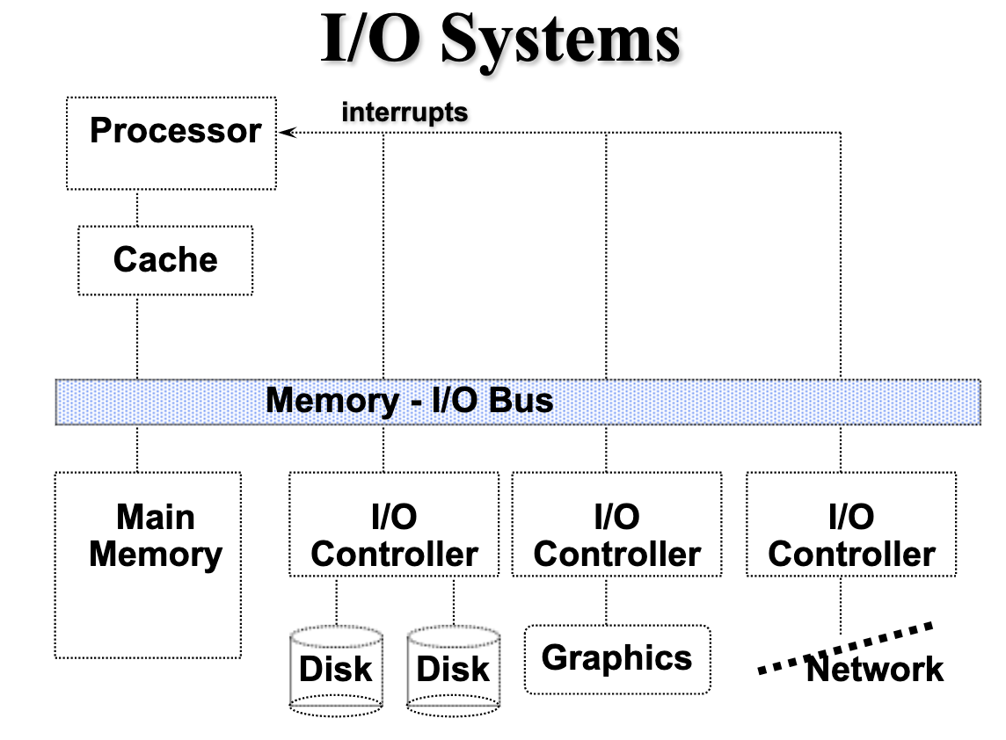
HDD (continued)
Disk Drive is attached to computer via I/O bus
Busses vary, including EIDE, ATA, SATA, USB, Fibre Channel, SCSI, SAS, Firewire
Host controller in computer uses bus to talk to disk controller built into drive or storage array
Disks can be removable

Slide 9
Hard Disk Performance
Access Latency = Average access time = average seek time + average latency
For fastest disk 3ms + 2ms = 5ms
For slow disk 9ms + 5.56ms = 14.56ms
Average I/O time = average access time + (amount to transfer / transfer rate) + controller overhead

Slide 10
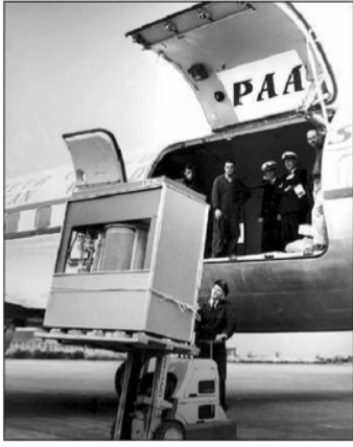
The first commercial Disk Drive
1956 IBM RAMDAC computer included the IBM Model 350 disk storage system
5M (7 bit) characters
50 x 24” platters
Access time = < 1 second

Slide 11
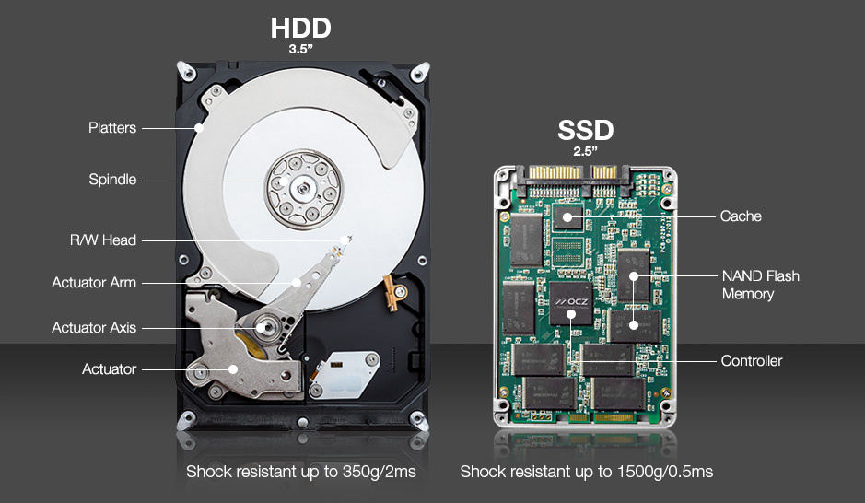
Solid-State Disks (SSD)
Nonvolatile memory used like a hard drive
Many technology variations
Can be more reliable than HDDs
More expensive per MB
Maybe have shorter life span
Less capacity but much faster
Busses can be too slow -> connect directly to PCI for example
No moving parts, so no seek time or rotational latency

Slide 12
Disk Structure
Disk drives are addressed as large 1-dimensional arrays of logical blocks, where the logical block is the smallest unit of transfer
Low-level formatting creates logical blocks on physical media
The 1-dimensional array of logical blocks is mapped into the sectors of the disk sequentially
Sector 0 is the first sector of the first track on the outermost cylinder  Mapping proceeds in order through that track, then the rest of the tracks in that cylinder, and then through the rest of the cylinders from outermost to innermost
Logical to physical address should be easy
Except for bad sectors

Slide 13
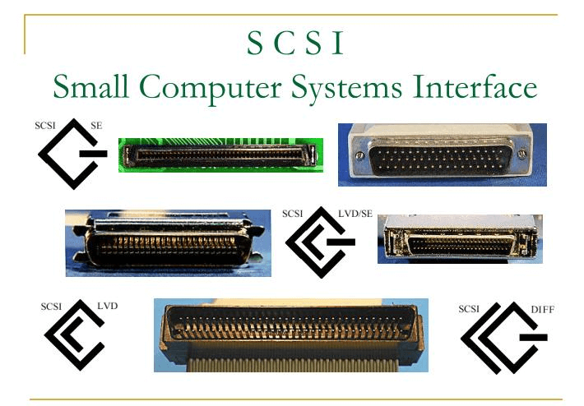
Disk Attachment
Direct-attached Storage (DAS) accessed through I/O ports talking to I/O busses
Small Computer System Interface (SCSI) is a bus, up to 16 devices on one cable
SCSI initiator requests operation and SCSI targets perform tasks
I/O directed to bus ID, device ID, logical unit (LUN)

Slide 14
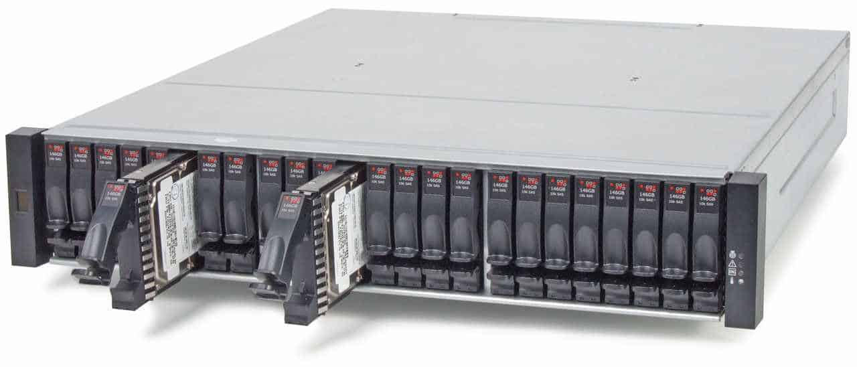
Storage Array
Disks are combined into arrays
Storage Array has controller(s), provides features to attached host(s)
Ports to connect hosts to array
Memory, controlling software
A few to thousands of disks
RAID: Redundant Array of Independent Disks
Shared storage -> more efficiency
Features like snapshots, replication, deduplication

Slide 15
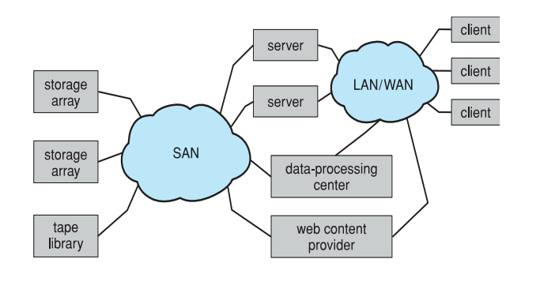
Storage Area Network (SAN)
Common in large storage environments
Multiple hosts attached to multiple storage arrays - flexible

Slide 16
Storage Area Network (continued)
SAN is one or more storage arrays
Connected to one or more Fibre Channel switches
Hosts also attach to the switches
Storage made available via LUN Masking from specific arrays to specific servers
Easy to add or remove storage, add new host and allocate it storage
Over low-latency Fibre Channel fabric
Separate storage networks and communications networks

Slide 17
Network-Attached Storage (NAS)
Network-attached storage (NAS) is storage made available over a network rather than over a local connection (such as a bus)
Remotely attaching to file systems
NFS is a common protocol
Implemented via remote procedure calls (RPCs) between host and storage over typically TCP or UDP on IP network
Uses IP network to carry the SCSI protocol
Remotely attaching to devices (blocks)

Slide 18
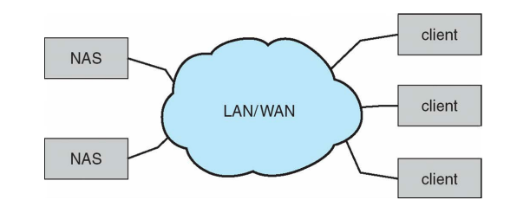
NAS continued

Slide 19
Software-Defined Storage (SDS)
Software-defined storage is a storage architecture for computer systems in which the storage management software is separated from the basic hardware.
With a structure that’s based on the concept of virtualization, a SDS storage environment for this purpose relies on a universal interface for accessing storage resources
specific software for the administration of individual storage devices unnecessary.
The entire storage capacity of the different hardware components can be centrally bundled and scaled in any dimension, or disseminated to the accessing clients.

Slide 20
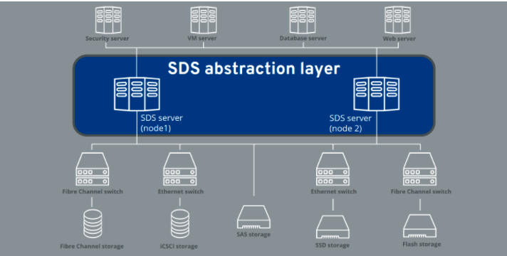
SDS continued
Notes:
https://www.ionos.ca/digitalguide/server/know-how/what-is-software-defined-storage/

Slide 21
Benefits of SDS
Scalability:
both the amount of storage offered to clients and the underlying hardware should be scalable without any performance issues or downtime. Scalability for clients should be automated.
A Standard Interface:
Management and maintenance of SDS should be easy for administrators and clients.
Supports different storage types
The SDS should support applications written for the object, file, or block storage.

Slide 22
Cloud Storage
Cloud Storage is implemented using SDS.
In the cloud provider’s data center, there are hundreds or thousands of physical hard drives sitting somewhere storing data, controlled by one or more servers.
a user can access the data using a network connection.
Focus is on performance and cost.

Slide 23

There are three common use cases for cloud storage
1
Content storage and delivery
Storage for data analytics and general compute
2
3
Backup and archival storage
Copyright Google LLC. For educational purposes in accordance with the terms of use set forth on the program Website.
23
Notes:
For cloud storage, there are three common use cases. The first is content storage and delivery. This is when users have content such as images or videos and they serve that content to end users wherever they are. People want their content fast, so running on the global network that Google provides makes for a great experience for end users.
The second use case is storage for data analytics and general compute. Users can process or expose their data to analytics tools like the analytics stack of products that Google Cloud offers and do things like genomic sequencing or IOT data analysis.
The third use case is backup and archival storage. Users can save storage costs by migrating infrequently accessed content to cheaper cloud storage options. Also, if anything happens to their data on-premises, it's critical to have a copy in the cloud for recovery purposes.

Slide 24
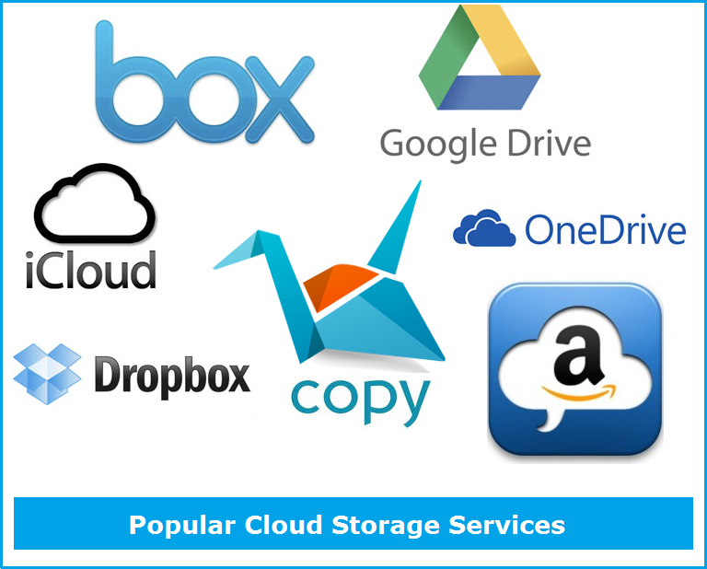
Example Cloud Storage Services
Notes:
https://www.kgntechnologies.com/list-of-popular-cloud-storage-services/

Slide 25
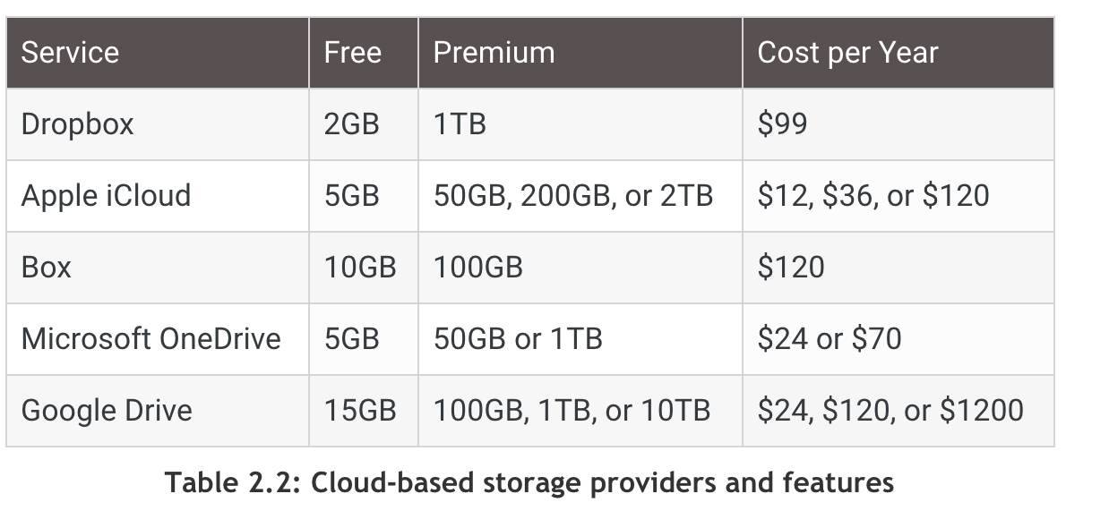
Cloud-based Storage providers
Each cloud storage provider offers slightly different features, and most of them will offer limited storage for free and premium services for more data-heavy users.
This table is for illustrative purposes only since the data storage limits and costs can change.

Slide 26
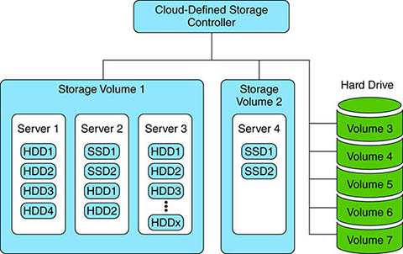
Local vs. Cloud storage
Local storage: the number of storage devices, and consequently the maximum storage space, is limited by the number of drive connections the computer has.
Cloud storage is implemented using software-defined storage (SDS).
A client has access to unlimited amount of storage
One physical disk can be divided into multiple virtual disks.
One logical unit of storage can be composed of multiple hard drives

Slide 27
One Tool does not fit all
To select the right storage for your data, you must understand
Data Dimensions:
variety, volume, velocity, value
storage temperature
Storage characteristics:
Temperature: hot vs. cold
Types: block, file, object, or managed storage services

Slide 28
Data Durability is the main goal
Data durability is the long-term protection of data.
Cloud providers express data durability as an annual percentage in nines:
two nines before the decimal point and as many nines as warranted after the decimal point.
For example, eleven nines of durability is expressed as 99.999999999%.
this means that the storage vendor is promising that your data will remain intact while it is under their care without losing any more than 0.000000001 percent of your data in a year.

Slide 29
What can affect data durability?
Data loss
can happen through human accident, natural or manmade disaster or even malicious action out of your control.
Data center managers go to great lengths to protect data under their care by:
locating a facility in as safe a geographical location as possible,
having secure facilities with controlled access, and
monitoring and maintaining the storage infrastructure
Data corruption
Data on traditional spinning hard drive systems can degrade with time, have errors introduced during copying, or become corrupted in any number of ways.

Slide 30
How is durability maintained?
Use software algorithms and metadata such as checksums to detect corruption of the data.
Redundancy by storing multiple copies of the data in multiple locations.

Slide 31
Data Dimensions
Velocity is the speed at which the data is being read or written
measured in reads-per-second (RPS) or writes-per-second (WPS)
batch processing, periodic, near-real-time, or real-time.
Variety determines how un/structured the data is.
structured, loosely structured, unstructured, or binary large objects (blobs).
unstructured has no entities or attributes.
A blob is treated as black box

Slide 32
Data Dimensions (continued)
Volume is the total size of the data set.
having more data is beneficial for getting insights from data.
the more data you can keep, is the less you need to guess of what to keep for future use.
Value: not all data are equally important.
depending on the value of the data, we are more or less willing to invest in additional durability.
Transient data: short-lived (e.g., Tweets) – durability is less important
Reproducible data: created to improve performance. Can be re-produced.
Authoritative data: source of truth. Invest in additional durability.
Critical/regulated: must retain at any cost. Durability and security are essential.

Slide 33
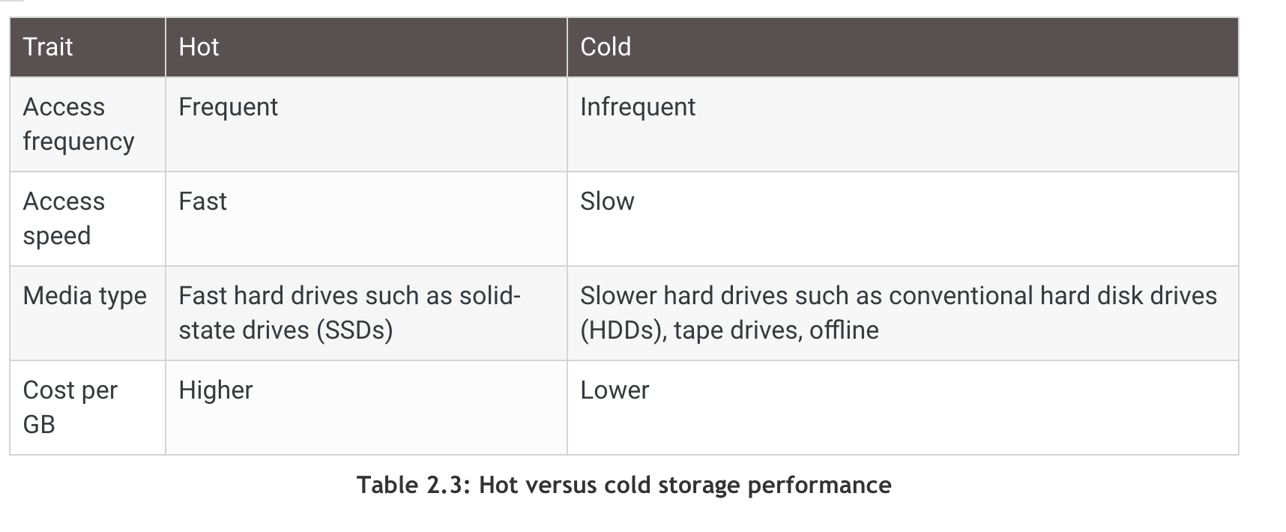
Storage Temperature
Hot storage is used for data that need to be readily available at all times.
read and writes tend to be single small items.
speed of access is essential
Cold storage is used for to data that isn't needed very often, such as archived data.
Data is accessed occasionally
updates are rare.
access might take from several minutes to several days.
High volume
Durability is needed

Slide 34
Additional Storage Temperature categories
Warm data is still being actively accessed, but less frequently than hot data.
items are read and updated in sets.
Speed of access is important but not crucial.
Frozen data need to preserved for business continuity or for archival.
never updates
reads are extremely infrequent
The same data can start as hot and then cool down.

Slide 35
Example Cloud Storage Services
Microsoft Azure:
premium, hot, cool, and archive tiers.
Google GCP:
Two hot options: multiregional storage and regional storage
nearline
cold line
AWS:
Simple Storage Service (S3) for hot data
S3 Glacier for archives.
Within S3 and S3 Glacier, there are multiple options to choose from.

Slide 36
GCP Storage Temperature Options
Storage Class | Minimum duration | Availability SLA | Typical monthly availability | Use cases | Name for APIs and gsutil
Standard Storage | None | Multi-region 99.95% Dual-region 99.95% Region 99.9% | >99.99% availability in multi-regions and dual-regions; 99.99% in regions | Access data frequently ("hot" data) and/or store for brief periods Serve website content Stream videos Interactive workloads Mobile and gaming apps | STANDARD
Nearline Storage | 30 days | Multi-region 99.9% Dual-region 99.9% Region 99.0% | 99.95% availability in multi-regions and dual-regions; 99.9% in regions | Read/modify data ≤ once per month Data backup Serve long-tail multimedia content | NEARLINE
Coldline Storage | 90 days |  |  | Read/modify data no more than once a quarter | COLDLINE
Archive Storage | 365 days | None |  | Read/modify data < once a year Cold data storage Disaster recovery | ARCHIVE
Copyright Google LLC. For educational purposes in accordance with the terms of use set forth on the program Website.
36
Notes:
Users have a variety of storage requirements for a multitude of use cases. Google offers different classes of Cloud Storage to cater for these requirements. The classes are based on how often data is accessed.
Standard Storage is best for data that is frequently accessed ("hot" data) and/or stored for only brief periods of time. When used in a region, co-locating your resources maximizes the performance for data-intensive computations and can reduce network charges. When used in a dual-region, you still get optimized performance when accessing Google Cloud products that are located in one of the associated regions, but you also get the improved availability that comes from storing data in geographically separate locations. When used in a multi-region, Standard Storage is appropriate for storing data that is accessed around the world, such as serving website content, streaming videos, executing interactive workloads, or serving data supporting mobile and gaming applications.
Nearline Storage is a low-cost, highly durable storage service for storing infrequently accessed data. Nearline Storage is a better choice than Standard Storage in scenarios where slightly lower availability, a 30-day minimum storage duration, and costs for data access are acceptable trade-offs for lowered at-rest storage costs. Nearline Storage is ideal for data you plan to read or modify on average once per month or less. Nearline Storage is appropriate for data backup, long-tail multimedia content, and data archiving.
Coldline Storage is a very-low-cost, highly durable storage service for storing infrequently accessed data. Coldline Storage is a better choice than Standard Storage or Nearline Storage in scenarios where slightly lower availability, a 90-day minimum storage duration, and higher costs for data access are acceptable trade-offs for lowered at-rest storage costs. Coldline Storage is ideal for data you plan to read or modify at most once a quarter.
Archive Storage is the lowest-cost, highly durable storage service for data archiving, online backup, and disaster recovery. Archive Storage has higher costs for data access and operations, as well as a 365-day minimum storage duration. Archive Storage is the best choice for data that you plan to access less than once a year. For example, cold data storage, such as data stored for legal or regulatory reasons, and disaster recovery.
Cloud Storage is unique in a number of ways, it has a single API, millisecond data access latency, and eleven 9s durability across all storage classes. Cloud Storage also offers object lifecycle management, which uses policies to automatically move data to lower cost storage classes as it is accessed less frequently throughout its life.
For more information, see: https://cloud.google.com/storage/docs/storage-classes

Slide 37


AWS Storage Temperature Options
Amazon S3 lifecycle policies enable you to delete or move objects based on age.
Amazon S3 Standard
Amazon S3 Standard - Infrequent Access
Amazon
S3 Glacier
Delete
30 days
60 days
365 days
Preview2.mp4
Preview2.mp4
Preview2.mp4
Notes:
You should automate the lifecycle of the data that you store in Amazon S3. By using lifecycle policies, you can cycle data at regular intervals between different Amazon S3 storage types. This automation reduces your overall cost, because you pay less for data as it becomes less important with time.
In addition to setting lifecycle rules per object, you can also set lifecycle rules per bucket.
Consider an example of a lifecycle policy that moves data as it ages from Amazon S3 Standard to Amazon S3 Standard – Infrequent Access, and finally, into Amazon S3 Glacier before it is deleted. Suppose that a user uploads a video to your application and your application generates a thumbnail preview of the video. This video preview is stored to Amazon S3 Standard, because it is likely that the user wants to access it right away.
Your usage data indicates that most thumbnail previews are not accessed after 30 days. Your lifecycle policy takes these previews and moves them to Amazon S3 – Infrequent Access after 30 days. After another 30 days elapse, the preview is unlikely to be accessed again. The preview is then moved to Amazon S3 Glacier, where it remains for 1 year. After 1 year, the preview is deleted. The important thing is that the lifecycle policy manages all this movement automatically.
To learn more, see Object lifecycle management

Slide 38
Cloud Storage Containers
When a client uploads data to the cloud, that data is placed into a storage container.
AWS and Google Cloud use the term bucket, whereas Azure uses blob.
Cloud-service providers (or CSPs) allow clients to have multiple containers to meet their storage needs.
The hotter the service and the more features it has, the more you will pay per gigabyte.

Slide 39
Cloud Storage Security
Shared responsibility Model
Cloud service provider
Security of Hardware and services
Consumer:
Access control
encryption

Slide 40
Cloud Storage Models
At the hardware level, data is stored as long strings of 1s and 0s on its storage media.
It's up to the device's OS or software to interpret the data and know where a relevant piece of information starts and stops.
How the data is logically organized into groups and accessed can make a big performance difference.

Slide 41
Cloud Storage Models
File system
AWS Elastic File System (EFS)
GCP FileStore
Block storage
AWS Elastic Block Store (EBS)
GCP Persistent Disk (PD)
Object stores
AWS Simple Storage Service (AWS S3)
GCP Cloud Storage Buckets

Slide 42
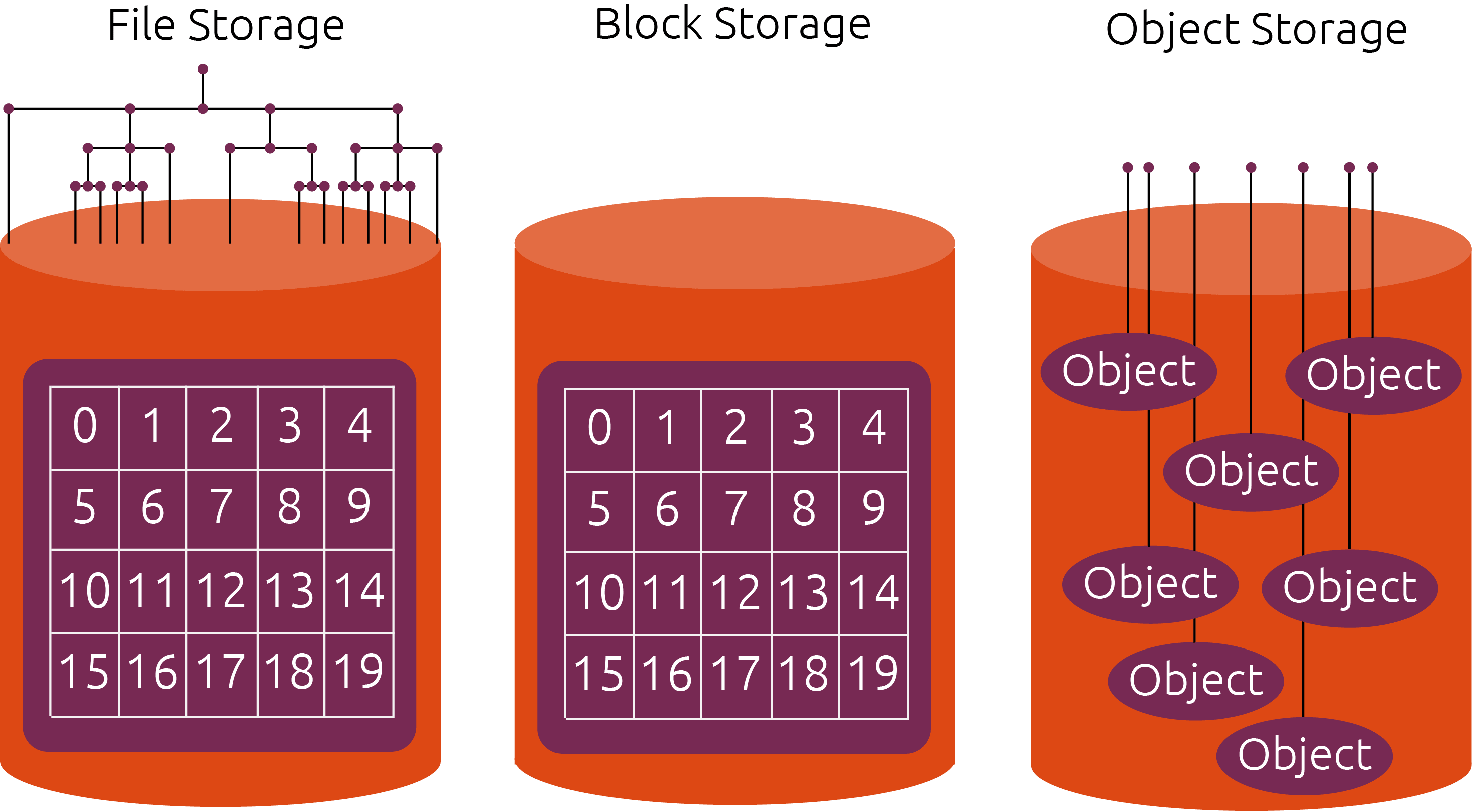
Notes:
https://ubuntu.com/blog/what-are-the-different-types-of-storage-block-object-and-file

Slide 43
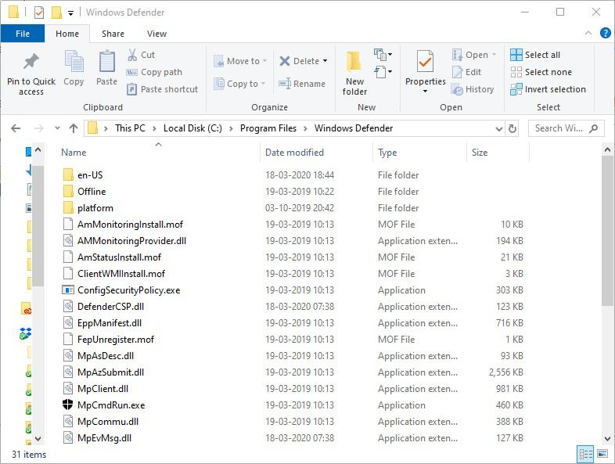
Storage Models (1/3): File storage
Files are organized into hierarchical folder structure
Each file has a unique path
Standard API – Portable Operating System Interface (POSIX):
access: command line tools, graphical user interface, or APIs
operations: create, read, write, or delete files and folders.
OSes have built-in file systems that manage files.
Windows: New Technology File System (NTFA)
Macs: Apple File System (APFS)
Linux: fourth extended file system (ext3 and ext4)

Slide 44
File Systems (continued)
Characteristics:
each file system maintains a table that tracks all files and includes a pointer to where each file resides.
the pointer system and the way that files are written to hard drives, it's entirely possible (and likely) that c:\files\doc1.txt and c:\files\doc2.txt are in completely different locations on the hard drive.
most file systems are specific to an OS
Not efficient for vey large data sets
Disadvantages:
no support for enforcing conventions concerning the representation of data elements and their relationships (e.g., comma-separated-value (csv) vs. jpg).
the need to maintain consistency as multiple processes read and write a file system can lead to bottlenecks in file system implementations.

Slide 45
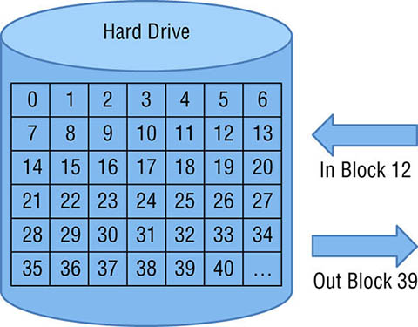
Storage Types (2/3): Block storage
With file storage, each file is treated as its singular entity, regardless of how small or large it is.
With block storage, files are split into chunks of data of equal size, assigned a unique identifier, and then stored on the hard drive. Because each piece of data has a unique address, a file structure is not needed.
Characteristics:
files are broken into more manageable chunks rather than being stored as one entity.
OS can modify one portion of a file without needing to open the entire file.
data transfers are more efficient and therefore faster because data is read and written in equal sized blocks.

Slide 46
Storage Types (3/3): Object storage
Object storage can make the organization and retrieval of unstructured data easier.
Pictures and videos are two examples of unstructured data they don't have a predefined data model, and they can't be organized in a predefined structure.
In object storage, every unit of storage is called an object. There's no predefined size or structure for each object. Example objects:
small text file.
a two-hour-long movie.
a song.
anything that anyone wants to store

Slide 47
Object storage (continued)
An object/blob store simplifies the file system model in important ways:
eliminates hierarchy
only two-level folder-file hierarchy that allows for the creation of object containers, each of which can hold zero or more objects.
forbids updates to objects once created.
Objects cannot be modified once uploaded: they can only be deleted or replaced.

Slide 48
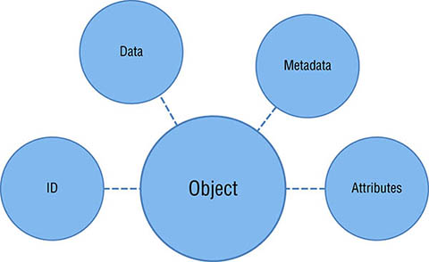
Object characteristics
The Data:
This is the data for the object itself the bits that make up the file or image or whatever it is that's being stored.
Metadata Describing the Object:
Metadata is optional information about the object.
describes the object, what it's used for, or anything else that will be relevant for people trying to find the object.
Object Attributes:
classifications of metadata, such as color, person, or other relevant characteristics.
optional but can make it easier to compare different unstructured data sets.
A Unique Identifying ID:
Each object needs a unique ID within the system in which it resides.
As with block storage, there is no hierarchical folder structure.

Slide 49
Example Object Container

Slide 50
Object Stores (continued)
Advantages:
The fact that objects cannot be modified once created makes it easy to build highly scalable and reliable implementations
An object can be replicated without the need for specialized synchronization logic.
Objects can be moved manually or automatically among storage classes with different performance ff and cost parameters.
Limitations:
provides little support for organizing data (no hierarchy)
no support for structured data
no support for search
A user must know an object’s identifier in order to access it. A user must know an object’s identifier in order to access it.
cannot be mounted as a file system.

Slide 51
Object vs. Block Storage
Size:
In block storage, every storage unit is of the same size
object storage sets no restrictions on object size. Similarly, there is no limit to how much metadata can be created for any object. The result is a completely flexible and customizable data storage solution.
Update:
in object storage, the entire object must be opened to modify any part of it.
This difference has a major effect on the throughput, latency, and cost of your storage solution. Block storage solutions are typically faster and use less bandwidth, but they can cost more than object-level storage.

Slide 52
Other Cloud Storage Services
Relational databases
NoSQL databases
Graph databases
Data warehouses
Archival storage.

Slide 53
Storage Models (1/5): Relational Databases
A database is a structured collection of data about entities and their relationships.
A database captures structure in ways that allow these entities and relationships to be queried for analysis.
A database management system (DBMS) is a software suite designed to safely store and efficiently manage databases
A DBMS encompasses three components:
data model (which defines how data are represented)
query language (which defines how the user interacts with the data)
support for transactions and crash recovery (to ensure reliable execution despite system failures).

Slide 54
Relational Databases (continued)
Tabular data:
rows represent entities and columns represent attributes.
SQL is used to execute a wide range of operations including joins.
Efficient execution of queries due to indexing and query planning techniques.
Two important properties:
Relational Algebra
ACID semantics:
Atomicity, Consistency, Isolation, and Durability

Slide 55
Relational Databases (continued)
Advantages:
simplifies data management and manipulation
provides for efficient querying and analysis
durable and reliable storage
scaling to large data sizes
validation of data formats
management of concurrent accesses.

Slide 56
Relational Databases in the Cloud
Amazon AWS:
Relational Database Service (RDS): allows you to set up a conventional relational database (e.g., MySQL or Postgres) on Amazon computers
Aurora: provides higher scalability, performance, and resilience than an RDS MySQL instance:
it can scale to many terabytes, replicate data across data centers (known as availability zones), and create m any read replicas to support large numbers of concurrent reads.
Google GCP:
Cloud SQL: relational database service.
Spanner: a globally distributed relational database that provides ACID transactions and SQL semantics with high scaling and availability
Microsoft Azure:
SQL Database: based on their mature SQL Server technology and is highly available and scalable.

Slide 57
Storage Models (2/5): NoSQL Databases
A relational DBMS is almost certainly the right technology to use for highly structured datasets of moderate size
NoSQL systems are used if your data is extremely large or is less regular (e.g., text or if different items have different properties).
NoSQL == non SQL or not-only SQL
non-SQL: they do not support the full relational algebra (e.g., no join).
not-only-SQL: most of SQL is supported but other properties are available.

Slide 58
NoSQL (continued)
Example NoSQL systems:
key-value stores: organize large numbers of records, each of which associates an arbitrary key with an arbitrary value.
document stores: permit text search on the stored values

Slide 59
NoSQL(continued)
Advantages:
rapid ingest of large quantities of unstructured data
Arbitrary data can be stored without modifications to a database schema
NoSQL databases in the cloud are often distributed over multiple servers and also replicated over different data centers
Limitations:
fail to satisfy all of the ACID properties
Eventual consistency: database state may be momentarily inconsistent across replicas.
This relaxation of ACID properties is acceptable if your concern is to respond rapidly to queries
It may be unacceptable if the data in question are, for example, medical records.

Slide 60
NoSQL in the cloud
Amazon AWS:
DynamoDB:
based on an extensible key-value model. For each row, the primary key column is the only required attribute, but any number of additional columns can be defined, indexed, and made searchable
Elastic Map-Reduce (EMR)
allows analysis of large quantities of data with Spark and other data analytics platforms
Google GCP:
Cloud Bigtable: highly scalable NoSQL database service
powers many core Google services, including Search, Analytics, Maps, and Gmail
designed to handle such large and sparse datasets in a manner that is efficient in space used and that supports massive workloads, while providing low latency and high bandwidth.
Cloud Datastore: implements ACID semantics and thus the user does not have to wait for possible inconsistencies to be resolved
Microsoft Azure:
Table: is a simple NoSQL key-value store, designed to support the highly reliable storage of any large number of key-value pairs.
HDInsight: provides an implementation of the Hadoop storage service hosted on Azure cloud computers
DocumentDB: supporting full text indexing and query, albeit at higher cost due to the greater resources needed for indexing.

Slide 61
Storage Models (3/5): Graph Databases
A graph is a data structure in which edges connect nodes.
Graphs are useful when we need to search data based on relationships among data items (e.g., social network friendship and following).
Often graph databases are built on top of existing NoSQL databases

Slide 62
Storage Models (4/5): Data Warehouses
Data warehouses are data management systems that are optimized to support analytic queries that involve reading large datasets.
Data warehouses have different design goals and properties than do DBMSs.
Examples:
A medical center’s clinical DBMS is typically designed to enable many concurrent requests to read and update information on individual patients (e.g., “what is Ms. Smith’ s current weight?” or “Mr. Jones was prescribed Aspirin”).
Data from this DBMS are uploaded periodically (e.g., once a day) into the medical center’s data warehouse to support aggregate queries such as “What factors are correlated with length of stay?”

Slide 63
Warehouse Analytics in the Cloud
Amazon AWS:
Redshift: designed to support high performance execution of analytic and reporting workloads against large datasets
Google GCP:
BigQuery: fully distributed and replicated, so durability is not an issue. It also supports SQL query semantics
Microsoft Azure:
Data Lake: a full suite of data analytics tools built on the open-source YARN and WebHDFS platforms

Slide 64
Storage Models (5/5): Archival Storage
Data archiving is the practice of identifying data that is no longer active and moving it out of production systems into long-term storage systems.
Archival data is stored so that at any time it can be brought back into service.

Slide 65
The Cloud Storage Landscape

Slide 66
Cloud Storage Parameters
Cost per gigabyte
Storage capacity limits
The maximum number of containers allowed
Data encryption
Storage compression and/or deduplication
If an intelligent analysis of storage usage and/or automated optimization is provided
Dynamic container resizing (e.g., capacity on demand)
Data read/write speed
Number of data reads/writes allowed, or cost per thousand reads/writes
Data latency for reads/writes
Data retrieval time for archives
Archived data retrieval cost

Slide 67
Cloud Storage Features
Compression
make files smaller so they take up less storage space.
works by looking for repeated information within a file and then replacing that information with a shorter string.
Deduplication
works at the file level or block level to eliminate duplicate data.
Example: an email server with a lot of file attachments, might be dozens or even hundreds of backed-up emails that contain the same attached Excel file
With deduplication, only one copy of that Excel file will be stored.
Deduplication can run as an inline process or a background process.
Capacity on Demand
if you need extra storage capacity, it is instantaneously available.
You just pay extra for the extra capacity that you use.
This can get tricky in some cases as you may end up paying much more than you expected.

Slide 68
Using Cloud Storage Services
Two main methods for managing data services:
Console: accomplish anything that you want to do with a few mouse clicks.
REST API: suitable for repetitive tasks (e.g., handling thousands of objects on a daily basis)
programmatical access to services through Software Development Kits (SDKs).
Cloud provider’s REST APIs and SDK are not identical.
Efforts for standard Python SDK:
CloudBridge
Apache Libcloud

Slide 69
Part 2
AWS Academy Cloud Foundations Course
Module 7: Storage

Slide 70
Module 7: Storage
AWS Academy Cloud Foundations
© 2019, Amazon Web Services, Inc. or its Affiliates. All rights reserved.
Notes:
Welcome to Module 7: Storage.

Slide 71
Module overview
Topics
Amazon Elastic Block Store (Amazon EBS)
Amazon Simple Storage Service (Amazon S3)
Amazon Elastic File System (Amazon EFS)
Amazon Simple Storage Service Glacier
Demos
Amazon EBS console
Amazon S3 console
Amazon EFS console
Amazon S3 Glacier console
Lab
Working with Amazon EBS
Notes:
Cloud storage is typically more reliable, scalable, and secure than traditional on-premises storage systems. Cloud storage is a critical component of cloud computing because it holds the information that applications use. Big data analytics, data warehouses, the Internet of Things (IoT), databases, and backup and archive applications all rely on some form of data storage architecture.
This module addresses the following topics:
Amazon Elastic Block Store (Amazon EBS)
Amazon Simple Storage Service (Amazon S3)
Amazon Elastic File System (Amazon EFS)
Amazon Simple Storage Service Glacier
This module includes four recorded demonstrations that show you how to use the AWS Management Console to create storage solutions.
This module includes a hands-on lab where you create an Amazon EBS volume, and then attach it to an Amazon Elastic Compute Cloud (Amazon EC2) instance. You also create a snapshot of your volume and then use the snapshot to create a new volume.

Slide 72
Module objectives
After completing this module, you should be able to:
Identify the different types of storage
Explain Amazon S3
Identify the functionality in Amazon S3
Explain Amazon EBS
Identify the functionality in Amazon EBS
Perform functions in Amazon EBS to build an Amazon EC2 storage solution
Explain Amazon EFS
Identify the functionality in Amazon EFS
Explain Amazon S3 Glacier
Identify the functionality in Amazon S3 Glacier
Differentiate between Amazon EBS, Amazon S3, Amazon EFS, and Amazon S3 Glacier
Notes:
The goal of this module is to discover key concepts that relate to storage. You will learn about the different types of storage resources that are available and review the different pricing options so that you can understand how different choices affect your solution cost.
After completing this module, you should be able to:
Identify the different types of storage
Explain Amazon S3
Identify the functionality in Amazon S3
Explain Amazon EBS
Identify the functionality in Amazon EBS
Perform functions in Amazon EBS to build an Amazon EC2 storage solution
Explain Amazon EFS
Identify the functionality in Amazon EFS
Explain Amazon S3 Glacier
Identify the functionality in Amazon S3 Glacier
Differentiate between Amazon EBS, Amazon S3, Amazon EFS, and Amazon S3 Glacier

Slide 73









Core AWS services
Amazon S3
Amazon EBS
Amazon
EFS
Amazon S3 Glacier
Amazon Virtual Private Cloud (Amazon VPC)
Amazon Elastic Compute Cloud (Amazon EC2)
AWS Identity and Access Management (IAM)
Storage
Amazon Relational
Database Service
Amazon DynamoDB
Database
Notes:
Storage is another AWS core service category. Some broad categories of storage include: instance store (ephemeral storage), Amazon EBS, Amazon EFS, Amazon S3, and Amazon S3 Glacier.
Instance store, or ephemeral storage, is temporary storage that is added to your Amazon EC2 instance.
Amazon EBS is persistent, mountable storage that can be mounted as a device to an Amazon EC2 instance. Amazon EBS can be mounted to an Amazon EC2 instance only within the same Availability Zone. Only one Amazon EC2 instance at a time can mount an Amazon EBS volume.
Amazon EFS is a shared file system that multiple Amazon EC2 instances can mount at the same time.
Amazon S3 is persistent storage where each file becomes an object and is available through a Uniform Resource Locator (URL); it can be accessed from anywhere.
Amazon S3 Glacier is for cold storage for data that is not accessed frequently (for example, when you need long-term data storage for archival or compliance reasons).

Slide 74
Section 1: Amazon Elastic Block Store (Amazon EBS)
Module 7: Storage
Notes:
Introduce Section 1: Amazon Elastic Block Store (Amazon EBS).

Slide 75
Storage
Amazon Elastic Block Store (Amazon EBS)
Notes:
Amazon EBS provides persistent block storage volumes for use with Amazon EC2 instances. Persistent storage is any data storage device that retains data after power to that device is shut off. It is also sometimes called non-volatile storage.
Each Amazon EBS volume is automatically replicated within its Availability Zone to protect you from component failure. It is designed for high availability and durability. Amazon EBS volumes provide the consistent and low-latency performance that is needed to run your workloads.
With Amazon EBS, you can scale your usage up or down within minutes, while paying a low price for only what you provision.

Slide 76

AWS storage options: Block storage versus object storage
What if you want to change one character in a 1-GB file?
Block storage
Object storage
Change one block (piece of the file)
that contains the character
Entire file must be updated
This difference has a major effect on the throughput, latency, and cost of your storage solution. Block storage solutions are typically faster and use less bandwidth, but they can cost more than object-level storage.
Notes:
What happens if you want to change one character in a 1-GB file? With block storage, you change only the block that contains the character. With object storage, the entire file must be updated.
One critical difference between some storage types is whether they offer block-level storage or object-level storage.
This difference has a major effect on the throughput, latency, and cost of your storage solution. Block storage solutions are typically faster and use less bandwidth, but they can cost more than object-level storage.

Slide 77
Amazon EBS
Amazon EBS enables you to create individual storage volumes and attach them to an Amazon EC2 instance:
Amazon EBS offers block-level storage.
Volumes are automatically replicated within its Availability Zone.
It can be backed up automatically to Amazon S3 through snapshots.
Uses include –
Boot volumes and storage for Amazon Elastic Compute Cloud (Amazon EC2) instances
Data storage with a file system
Database hosts
Enterprise applications
Notes:
Amazon EBS enables you to create individual storage volumes and attach them to an Amazon EC2 instance. Amazon EBS offers block-level storage, where its volumes are automatically replicated within its Availability Zone. Amazon EBS is designed to provide durable, detachable, block-level storage (which is like an external hard drive) for your Amazon EC2 instances. Because they are directly attached to the instances, they can provide low latency between where the data is stored and where it might be used on the instance.
For this reason, they can be used to run a database with an Amazon EC2 instance. Amazon EBS volumes are included as part of the backup of your instances into Amazon Machine Images (or AMIs). AMIs are stored in Amazon S3 and can be reused to create new Amazon EC2 instances later.
A backup of an Amazon EBS volume is called a snapshot. The first snapshot is called the baseline snapshot. Any other snapshot after the baseline captures only what is different from the previous snapshot.
Amazon EBS volumes uses include:
Boot volumes and storage for Amazon EC2 instances
Data storage with a file system
Database hosts
Enterprise applications

Slide 78
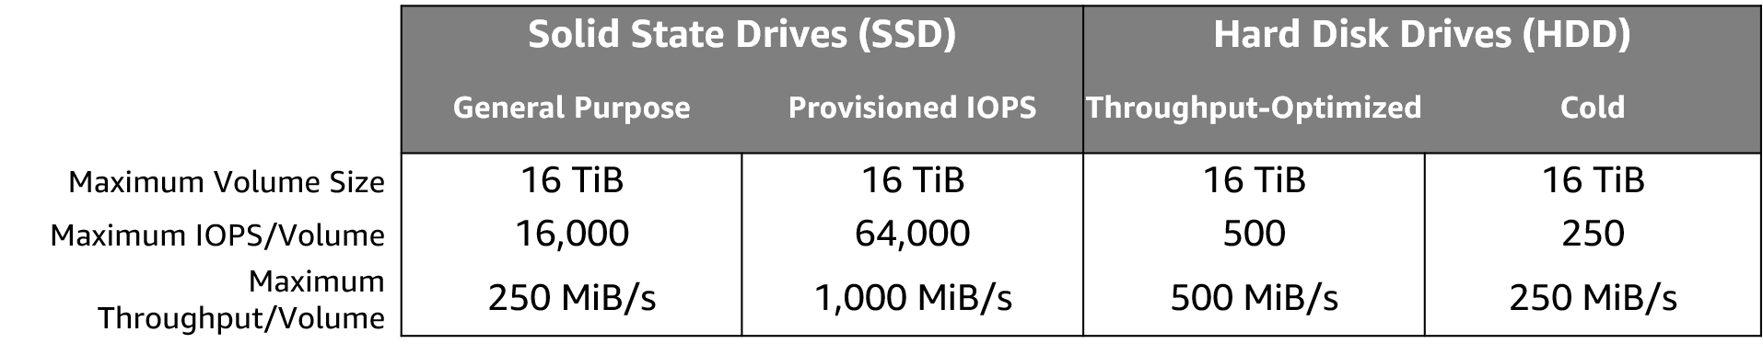
Amazon EBS volume types
Notes:
Matching the correct technology to your workload is a best practice for reducing storage costs. Provisioned IOPS SSD-backed Amazon EBS volumes can give you the highest performance. However, if your application doesn't require or won't use performance that high, General Purpose SSD is usually sufficient. Only SSDs can be used as boot volumes for EC2 instances. The lower-cost options might be a solution for additional storage or use cases other than boot volumes.
To learn more, see: EBS Volume Types

Slide 79
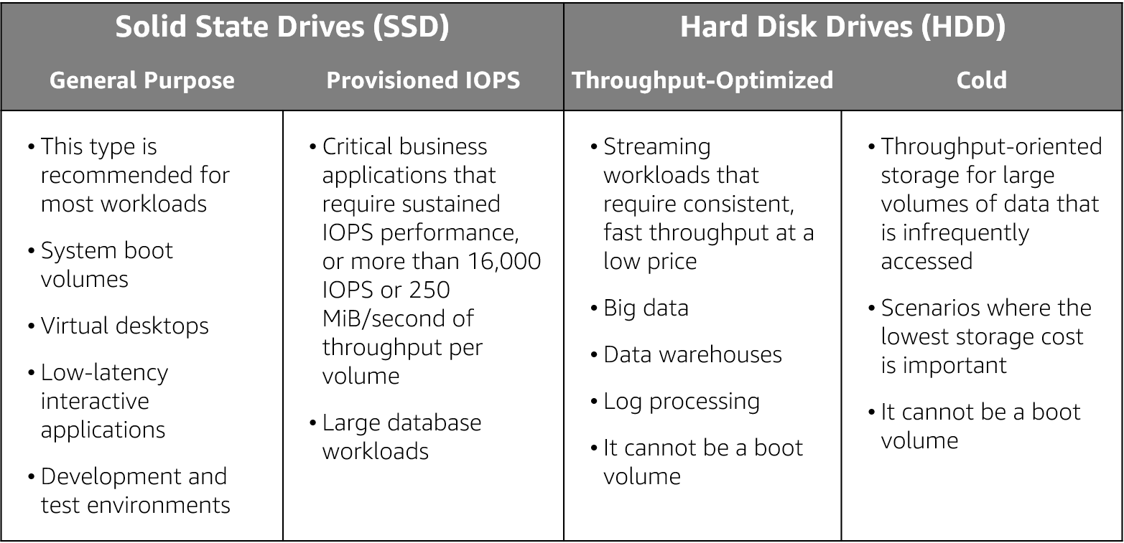
Amazon EBS volume type use cases
Notes:
As mentioned previously an Amazon EBS volume is a durable, block-level storage device that you can attach to a single EC2 instance. You can use Amazon EBS volumes as primary storage for data that requires frequent updates, such as the system drive for an instance or storage for a database application. You can also use them for throughput-intensive applications that perform continuous disk scans. Amazon EBS volumes persist independently from the running life of an EC2 instance.
Use cases for EBS vary by the storage type used and whether you are using General Purpose of Provisioned IOPS.

Slide 80



Amazon EBS features
Snapshots –
Point-in-time snapshots
Recreate a new volume at any time
Encryption –
Encrypted Amazon EBS volumes
No additional cost
Elasticity –
Increase capacity
Change to different types
Notes:
To provide an even higher level of data durability, Amazon EBS enables you to create point-in-time snapshots of your volumes, and you can re-create a new volume from a snapshot at any time. You can also share snapshots or even copy snapshots to different AWS Regions for even greater disaster recovery (DR) protection. For example, you can encrypt and share your snapshots from Virginia in the US to Tokyo, Japan.
You can also have encrypted Amazon EBS volumes at no additional cost, so the data that moves between the EC2 instance and the EBS volume inside AWS data centers is encrypted in transit.
As your company grows, the amount of data that is stored on your Amazon EBS volumes is also likely to grow. Amazon EBS volumes can increase capacity and change to different types, so you can change from hard disk drives (HDDs) to solid state drives (SSDs) or increase from a 50-GB volume to a 16-TB volume. For example, you can do this resize operation dynamically without needing to stop the instances.

Slide 81
Amazon EBS: Volumes, IOPS, and pricing
Volumes –
Amazon EBS volumes persist independently from the instance.
All volume types are charged by the amount that is provisioned per month.
IOPS –
General Purpose SSD:
Charged by the amount that you provision in GB per month until storage is released.
Magnetic:
Charged by the number of requests to the volume.
Provisioned IOPS SSD:
Charged by the amount that you provision in IOPS (multiplied by the percentage of days that you provision for the month).
Notes:
When you begin to estimate the cost for Amazon EBS, you must consider the following:
Volumes – Volume storage for all Amazon EBS volume types is charged by the amount you provision in GB per month, until you release the storage.
IOPS – I/O is included in the price of General Purpose SSD volumes. However, for Amazon EBS magnetic volumes, I/O is charged by the number of requests that you make to your volume. With Provisioned IOPS SSD volumes, you are also charged by the amount you provision in IOPS (multiplied by the percentage of days that you provision for the month).
The pricing and provisioning of Amazon EBS are complex. In general, you pay for the size of the volume and its usage. To learn more about the full, highly complex pricing and provisioning concepts of Amazon EBS,
For more information about pricing for General Purpose storage, see General Purpose SSD volumes.

Slide 82
Amazon EBS: Snapshots and data transfer
Snapshots –
Added cost of Amazon EBS snapshots to Amazon S3 is per GB-month of data stored.
Data transfer –
Inbound data transfer is free.
Outbound data transfer across Regions incurs charges.
Notes:
Snapshots – Amazon EBS enables you to back up snapshots of your data to Amazon S3 for durable recovery. If you opt for Amazon EBS snapshots, the added cost is per GB-month of data stored.
Data transfer – When you copy Amazon EBS snapshots, you are charged for the data that is transferred across Regions. After the snapshot is copied, standard Amazon EBS snapshot charges apply for storage in the destination Region.

Slide 83

Section 1 key takeaways
Amazon EBS features:
Persistent and customizable block storage for Amazon EC2
HDD and SSD types
Replicated in the same Availability Zone
Easy and transparent encryption
Elastic volumes
Back up by using snapshots
83
Notes:
Amazon EBS provides block-level storage volumes for use with Amazon EC2 instances. Amazon EBS volumes are off-instance storage that persists independently from the life of an instance. They are analogous to virtual disks in the cloud. Amazon EBS provides three volume types: General Purpose SSD, Provisioned IOPS SSD, and magnetic.
The three volume types differ in performance characteristics and cost, so you can choose the right storage performance and price for the needs of your applications.
Additional benefits include replication in the same Availability Zone, easy and transparent encryption, elastic volumes, and backup by using snapshots.
To learn more about Amazon EBS, see: Elastic Block Store.
.

Slide 84
Instance store
Notes:
Next, you will review the purpose and characteristics of an instance store.

Slide 85


Instance store
Instance store definition:
Non-persistent block-level storage on a shared-disk subsystem
Fast
Reclaimed when instance terminated
Complimentary with certain instances
Use cases:
Buffers
Cache
Scratch data
Instance 1
Instance 2
Ephemeral
0
Ephemeral
1
Ephemeral
2
Instances
Instance store
VM host computer in AWS
Notes:
An instance store provides temporary block-level storage for your instance. This storage is located on disks that are physically attached to the host computer. Instance store is ideal for temporary storage of information that changes frequently, such as buffers, caches, scratch data, and other temporary content.
An instance store consists of one or more instance store volumes exposed as block devices. The size of an instance store as well as the number of devices available varies by instance type. While an instance store is dedicated to a particular instance, the disk subsystem is shared among instances on a host computer.
NOTE: Instance-store backed instances cannot be stopped; they can only be terminated.
For more information, see: https://docs.aws.amazon.com/AWSEC2/latest/UserGuide/InstanceStorage.html

Slide 86
Instance store volumes
Instance store is available for many instance types but not all.
Number, size, and type (HDD vs. SSD) differs by instance type:
Instance stores that use NVMe have higher I/O performance.
Mounting:
Instance store must be mounted before you can access it.
Auto-mounted by Windows EC2Launch service
Typically manually mounted on Linux
Notes:
Some instance types do not support instance store volumes. For those that do support them, the number and size of available instance store volumes for an instance varies by instance type.
Instance types that use NVMe (Non-Volatile Memory express) or Serial Advanced Technology Attachment (SATA)-based solid state drives (SSD) deliver high random I/O performance. This is a good option when you need storage with very low latency, but you don't need the data to persist when the instance terminates.
You must specify the instance store volumes that you'd like to use when you launch an instance (except for NVMe instance store volumes, which are available by default). You can't make an instance store volume available after you launch the instance.
Once the instance is launched, the instance store volumes are available to the instance, but you can't access them until they are mounted. For Windows instances, the EC2Launch service mounts the instance store volumes for an instance. For Linux instances, the instance type determines which instance store volumes are mounted for you and which require you to mount yourself.
For more information on adding an instance store volume to an EC2 instance, see: https://docs.aws.amazon.com/AWSEC2/latest/UserGuide/add-instance-store-volumes.html#adding-instance-storage-instance

Slide 87

Key Takeaways
Instance store is temporary block storage physically attached to an instance that is physically attached to a host.
Use an instance store to store information that does not need to be kept beyond instance life.
© 2019 Amazon Web Services, Inc. or its Affiliates. All rights reserved.
87
Notes:
Some key takeaways from this section include:
Instance store is temporary block storage physically attached to an instance that is physically attached to a host.
Use an instance store for storage of information that does not need to be kept beyond the life of the instance.

Slide 88

Lab 4: Working with Amazon EBS
88
Notes:
You will now work on Lab 4: Working with Amazon EBS.

Slide 89

Lab 4: Scenario
This lab is designed to show you how to create an Amazon EBS volume. After you create the volume, you will attach the volume to an Amazon EC2 instance, configure the instance to use a virtual disk, create a snapshot and then restore from the snapshot.
Attached
Created
Amazon EC2 instance
Amazon EBS
Snapshot
Notes:
This lab is designed to show you how to create an Amazon EBS volume. After you create the volume, you will attach the volume to an Amazon EC2 instance, configure the instance to use a virtual disk, create a snapshot and then restore from the snapshot.
After completing this lab, you should be able to:
Create an Amazon EBS volume
Attach that volume to an instance
Configure the instance to use the virtual disk
Create an Amazon EBS snapshot
Restore the snapshot

Slide 90
Lab 4: Final product
Attached
Created
Amazon EC2 instance
Amazon EBS
Snapshot
Notes:
In this lab, you:
Created an Amazon EBS volume
Attached that volume to an instance
Configured the instance to use the virtual disk
Created an Amazon EBS snapshot
Restored the snapshot

Slide 91
Section 2: Amazon Simple Storage Service (Amazon S3)
Module 7: Storage
Notes:
Introduce Section 3: Amazon Simple Storage Service.
Companies need the ability to simply and securely collect, store, and analyze their data on a massive scale. Amazon S3 is object storage that is built to store and retrieve any amount of data from anywhere: websites and mobile apps, corporate applications, and data from Internet of Things (IoT) sensors or devices.

Slide 92
Storage
Object storage service that offers industry-leading scalability, data availability, security, and performance
Offers 99.999999999% (11 nines) of durability
Provides easy-to-use management features
Bucket names are universal and must be unique across all existing bucket names in Amazon S3.
Amazon Simple Storage Service (Amazon S3)
Notes:
Amazon S3 is object-level storage, which means that if you want to change a part of a file, you must make the change and then re-upload the entire modified file. Amazon S3 stores data as objects within resources that are called buckets.
You will now learn more about Amazon S3.

Slide 93


Amazon S3 overview
Data is stored as objects in buckets
Virtually unlimited storage
Single object is limited to 5 TB
Designed for 11 9s of durability
Granular access to bucket and objects
Notes:
Amazon S3 is a managed cloud storage solution that is designed to scale seamlessly and provide 11 9s of durability. You can store virtually as many objects as you want in a bucket, and you can write, read, and delete objects in your bucket. Bucket names are universal and must be unique across all existing bucket names in Amazon S3. Objects can be up to 5 TB in size. By default, data in Amazon S3 is stored redundantly across multiple facilities and multiple devices in each facility.
The data that you store in Amazon S3 is not associated with any particular server, and you do not need manage any infrastructure yourself. You can put as many objects into Amazon S3 as you want. Amazon S3 holds trillions of objects and regularly peaks at millions of requests per second.
Objects can be almost any data file, such as images, videos, or server logs. Because Amazon S3 supports objects as large as several terabytes in size, you can even store database snapshots as objects. Amazon S3 also provides low-latency access to the data over the internet by Hypertext Transfer Protocol (HTTP) or Secure HTTP (HTTPS), so you can retrieve data anytime from anywhere. You can also access Amazon S3 privately through a virtual private cloud (VPC) endpoint. You get fine-grained control over who can access your data by using AWS Identity and Access Management (IAM) policies, Amazon S3 bucket policies, and even per-object access control lists.
By default, none of your data is shared publicly. You can also encrypt your data in transit and choose to enable server-side encryption on your objects.
You can access Amazon S3 through the web-based AWS Management Console; programmatically through the API and SDKs; or with third-party solutions, which use the API or the SDKs.
Amazon S3 includes event notifications that enable you to set up automatic notifications when certain events occur, such as when an object is uploaded to a bucket or deleted from a specific bucket. Those notifications can be sent to you, or they can be used to trigger other processes, such as AWS Lambda functions.
With storage class analysis, you can analyze storage access patterns and transition the right data to the right storage class. The Amazon S3 Analytics feature automatically identifies the optimal lifecycle policy to transition less frequently accessed storage to Amazon S3 Standard – Infrequent Access (Amazon S3 Standard-IA). You can configure a storage class analysis policy to monitor an entire bucket, a prefix, or an object tag.
When an infrequent access pattern is observed, you can easily create a new lifecycle age policy that is based on the results. Storage class analysis also provides daily visualizations of your storage usage in the AWS Management Console. You can export them to an Amazon S3 bucket to analyze by using the business intelligence (BI) tools of your choice, such as Amazon QuickSight.

Slide 94





Amazon S3 use cases
Content storage and distribution
Backup and restore; archive
Data lakes and big data analytics
Disaster recovery
Static website hosting
Notes:
There are many use cases for Amazon S3, such as content storage and distribution, backup and restore, archiving, data lakes and big data analytics, disaster recovery, and static website hosting.
You can securely store static content—such as images, videos, and music—to Amazon S3, and then distribute the content directly from Amazon S3 or through Amazon CloudFront edge locations.
Case Study: Classle is a cloud-based social learning platform that allows students to connect with other students and professionals from various areas. Amazon S3, with the Reduced Redundancy Storage (RRS) feature, serves the dual function of providing Classle’s content downloads and acting as an origin server for Amazon CloudFront. Read the case study: https://aws.amazon.com/solutions/case-studies/classle/.
You can back up your data and use storage lifecycle policies to archive rarely accessed data to Amazon S3 Glacier.
Case Study: Celgene uses Amazon S3 and Amazon Glacier to store hundreds of terabytes of genomic data. “Some of our genomic files are 200 gigabytes each in size, after compression, so we need the robust storage capabilities of Amazon S3 and Amazon Glacier,” says Lance Smith, associate director of IT at Celgene. Read the case study: https://aws.amazon.com/solutions/case-studies/celgene/
You can create a data lake in Amazon S3. A data lake is a centralized repository that allows you to store all your structured and unstructured data at any scale. With a data lake, you can extract valuable insights using query-in-place, analytics, and machine learning tools.
Case Study: The UK Data Service is responsible for the United Kingdom’s largest collection of economic and social data, used by researchers, policy makers, and private companies. It uses Amazon S3 to store the cloud-based portion of its data lake. Read the case study: https://aws.amazon.com/solutions/case-studies/uk-data-service/
The highly durable, secure, global infrastructure provided by Amazon S3 offers a robust disaster recovery solution. You can use Amazon S3 to protect critical data, applications, and IT systems that are running in the AWS Cloud or in your on-premises environment without incurring the expense of a second physical site. Cross-Region replication (CRR) enables automatic, asynchronous copying of objects across buckets in different AWS Regions.
Case Study: 6 Waves Limited is a leading publisher and developer of gaming applications on the Facebook platform. 6 Waves uses Amazon S3 and Amazon Elastic Compute Cloud (Amazon EC2) services to host over 50 million players monthly on their online games. The decoupling of storage from server instances largely simplifies disaster recovery and sizing. Read the case study: https://aws.amazon.com/solutions/case-studies/6waves/.
You can use Amazon S3 to host a static website. On a static website, individual webpages include static content. They might also contain client-side scripts. By contrast, a dynamic website relies on server-side processing, including server-side scripts such as PHP, JSP, or ASP.NET. Amazon S3 does not support server-side scripting.
For more information, see Hosting a Static Website on Amazon S3: https://docs.aws.amazon.com/AmazonS3/latest/dev/WebsiteHosting.html

Slide 95
Amazon S3 storage classes
Amazon S3 offers a range of object-level storage classes that are designed for different use cases:
Amazon S3 Standard
Amazon S3 Intelligent-Tiering
Amazon S3 Standard-Infrequent Access (Amazon S3 Standard-IA)
Amazon S3 One Zone-Infrequent Access (Amazon S3 One Zone-IA)
Amazon S3 Glacier
Amazon S3 Glacier Deep Archive
Notes:
Amazon S3 offers a range of object-level storage classes that are designed for different use cases. These classes include:
Amazon S3 Standard – Amazon S3 Standard is designed for high durability, availability, and performance object storage for frequently accessed data. Because it delivers low latency and high throughput, Amazon S3 Standard is appropriate for a variety of use cases, including cloud applications, dynamic websites, content distribution, mobile and gaming applications, and big data analytics.
Amazon S3 Intelligent-Tiering – The Amazon S3 Intelligent-Tiering storage class is designed to optimize costs by automatically moving data to the most cost-effective access tier, without performance impact or operational overhead. For a small monthly monitoring and automation fee per object, Amazon S3 monitors access patterns of the objects in Amazon S3 Intelligent-Tiering, and moves the objects that have not been accessed for 30 consecutive days to the infrequent access tier. If an object in the infrequent access tier is accessed, it is automatically moved back to the frequent access tier. There are no retrieval fees when you use the Amazon S3 Intelligent-Tiering storage class, and no additional fees when objects are moved between access tiers. It works well for long-lived data with access patterns that are unknown or unpredictable.
Amazon S3 Standard-Infrequent Access (Amazon S3 Standard-IA) – The Amazon S3 Standard-IA storage class is used for data that is accessed less frequently, but requires rapid access when needed. Amazon S3 Standard-IA is designed to provide the high durability, high throughput, and low latency of Amazon S3 Standard, with a low per-GB storage price and per-GB retrieval fee. This combination of low cost and high performance makes Amazon S3 Standard-IA good for long-term storage and backups, and as a data store for disaster recovery files.
Amazon S3 One Zone-Infrequent Access (Amazon S3 One Zone-IA) – Amazon S3 One Zone-IA is for data that is accessed less frequently, but requires rapid access when needed. Unlike other Amazon S3 storage classes, which store data in a minimum of three Availability Zones, Amazon S3 One Zone-IA stores data in a single Availability Zone and it costs less than Amazon S3 Standard-IA. Amazon S3 One Zone-IA works well for customers who want a lower-cost option for infrequently accessed data, but do not require the availability and resilience of Amazon S3 Standard or Amazon S3 Standard-IA. It is a good choice for storing secondary backup copies of on-premises data or easily re-creatable data. You can also use it as cost-effective storage for data that is replicated from another AWS Region by using Amazon S3 Cross-Region Replication.
Amazon S3 Glacier – Amazon S3 Glacier is a secure, durable, and low-cost storage class for data archiving. You can reliably store any amount of data at costs that are competitive with—or cheaper than—on-premises solutions. To keep costs low yet suitable for varying needs, Amazon S3 Glacier provides three retrieval options that range from a few minutes to hours. You can upload objects directly to Amazon S3 Glacier, or use Amazon S3 lifecycle policies to transfer data between any of the Amazon S3 storage classes for active data (Amazon S3 Standard, Amazon S3 Intelligent-Tiering, Amazon S3 Standard-IA, and Amazon S3 One Zone-IA) and Amazon S3 Glacier.
Amazon S3 Glacier Deep Archive – Amazon S3 Glacier Deep Archive is the lowest-cost storage class for Amazon S3. It supports long-term retention and digital preservation for data that might be accessed once or twice in a year. It is designed for customers — particularly customers in highly regulated industries, such as financial services, healthcare, and public sectors — that retain datasets for 7–10 years (or more) to meet regulatory compliance requirements. Amazon S3 Glacier Deep Archive can also be used for backup and disaster recovery use cases. It is a cost-effective and easy-to-manage alternative to magnetic tape systems, whether these tape systems are on-premises libraries or off-premises services. Amazon S3 Glacier Deep Archive complements Amazon S3 Glacier, and it is also designed to provide 11 9s of durability. All objects that are stored in Amazon S3 Glacier Deep Archive are replicated and stored across at least three geographically dispersed Availability Zones, and these objects can be restored within 12 hours.
For more information see, Amazon S3 storage classes.

Slide 96


Amazon S3 bucket URLs (two styles)
Amazon S3
To upload your data:
Create a bucket in an AWS Region.
Upload almost any number of objects to the bucket.
Bucket path-style URL endpoint:
[bucket name]
https://s3.ap-northeast-1.amazonaws.com/bucket-name
Region code
Bucket name
Bucket virtual hosted-style URL endpoint:
Preview2.mp4
https:// bucket-name.s3-ap-northeast-1.amazonaws.com
Tokyo Region (ap-northeast-1)
Bucket name
Region code
Notes:
To use Amazon S3 effectively, you must understand a few simple concepts. First, Amazon S3 stores data inside buckets. Buckets are essentially the prefix for a set of files, and must be uniquely named across all of Amazon S3 globally. Buckets are logical containers for objects. You can have one or more buckets in your account. You can control access for each bucket—who can create, delete, and list objects in the bucket. You can also view access logs for the bucket and its objects, and choose the geographical region where Amazon S3 stores the bucket and its contents.
To upload your data (such as photos, videos, or documents), create a bucket in an AWS Region, and then upload almost any number of objects to the bucket.
In the example, Amazon S3 was used to create a bucket in the Tokyo Region, which is identified within AWS formally by its Region code: ap-northeast-1
The URL for a bucket is structured like the examples. You can use two different URL styles to refer to buckets.
Amazon S3 refers to files as objects. As soon as you have a bucket, you can store almost any number of objects inside it. An object is composed of data and any metadata that describes that file, including a URL. To store an object in Amazon S3, you upload the file that you want to store to a bucket.
When you upload a file, you can set permissions on the data and any metadata.
In this example, the object Preview2.mp4 is stored inside the bucket. The URL for the file includes the object name at the end.

Slide 97

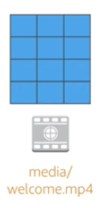
Data is redundantly stored in the Region
media/welcome.mp4
Facility 1
Facility 2
Facility 3
my-bucket-name
Region
Notes:
When you create a bucket in Amazon S3, it is associated with a specific AWS Region. When you store data in the bucket, it is redundantly stored across multiple AWS facilities within your selected Region.
Amazon S3 is designed to durably store your data, even if there is concurrent data loss in two AWS facilities.

Slide 98

Designed for seamless scaling
media/welcome.mp4
prod2.mp4
prod3.mp4
prod4.mp4
prod5.mp4
prod6.mp4
prod7.mp4
prod8.mp4
my-bucket-name
prod9.mp4
prod10.mp4
prod11.mp4
prod12.mp4
Notes:
Amazon S3 automatically manages the storage behind your bucket while your data grows. You can get started immediately, and your data storage will grow with your application needs.
Amazon S3 also scales to handle a high volume of requests. You do not need to provision the storage or throughput, and you are billed only for what you use.

Slide 99



Access the data anywhere
AWS Management Console
AWS Command Line Interface
SDK
Notes:
You can access Amazon S3 through the console, AWS Command Line Interface (AWS CLI), or AWS SDK. You can also access the data in your bucket directly by using REST-based endpoints.
The endpoints support HTTP or HTTPS access. To support this type of URL-based access, Amazon S3 bucket names must be globally unique and Domain Name Server (DNS)-compliant.
Also, object keys should use characters that are safe for URLs.

Slide 100

Common use cases
Storing application assets
Static web hosting
Backup and disaster recovery (DR)
Staging area for big data
Many more….
Notes:
This flexibility to store a virtually unlimited amount of data—and to access that data from anywhere—means that Amazon S3 is suitable for a variety of scenarios. You will now consider some use cases for Amazon S3:
As a location for any application data, Amazon S3 buckets provide a shared location for storing objects that any instances of your application can access—including applications on Amazon EC2 or even traditional servers. This feature can be useful for user-generated media files, server logs, or other files that your application must store in a common location. Also, because the content can be fetched directly over the internet, you can offload serving that content from your application and enable clients to directly fetch the data from Amazon S3 themselves.
For static web hosting, Amazon S3 buckets can serve the static contents of your website, including HTML, CSS, JavaScript, and other files.
The high durability of Amazon S3 makes it a good candidate for storing backups of your data. For greater availability and disaster recovery capability, Amazon S3 can even be configured to support cross-Region replication so that data in an Amazon S3 bucket in one Region can be automatically replicated to another Amazon S3 Region.

Slide 101

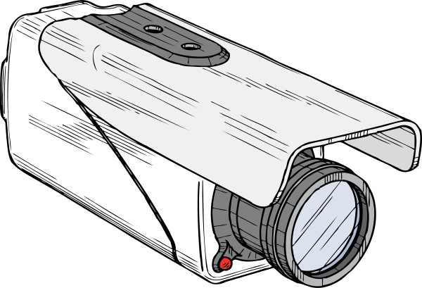
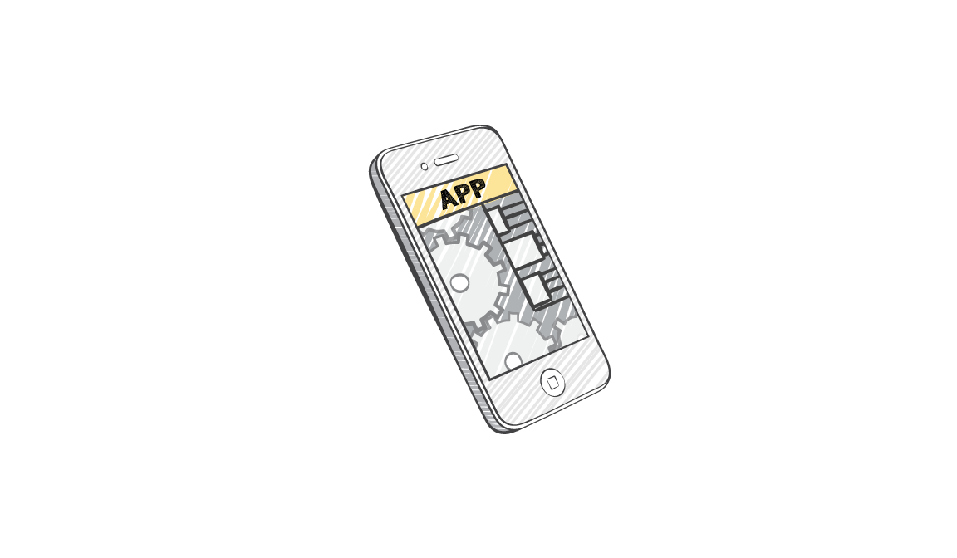


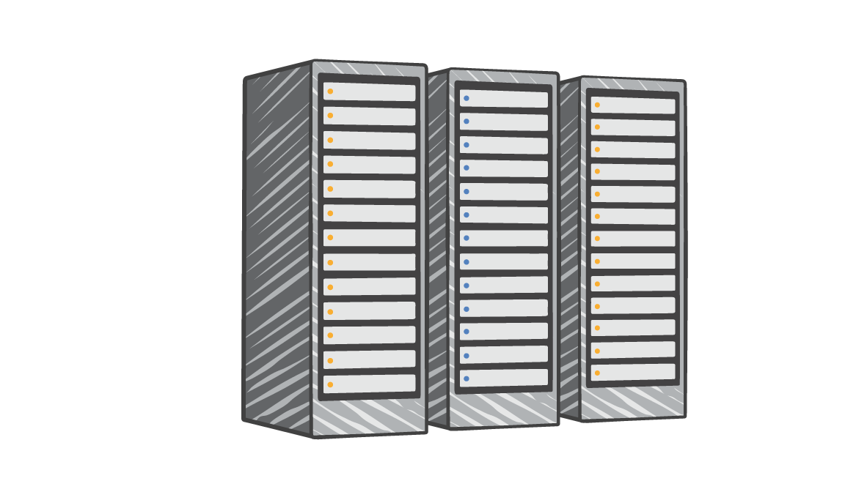
Amazon S3 common scenarios
Backup and storage
Application hosting
Media hosting
Software delivery
Amazon S3 buckets
Corporate data center
Amazon EC2 instances
Notes:
Backup and storage – Provide data backup and storage services for others
Application hosting – Provide services that deploy, install, and manage web applications
Media hosting – Build a redundant, scalable, and highly available infrastructure that hosts video, photo, or music uploads and downloads
Software delivery – Host your software applications that customers can download

Slide 102
Amazon S3 pricing
Pay only for what you use, including –
GBs per month
Transfer OUT to other Regions
PUT, COPY, POST, LIST, and GET requests
You do not pay for –
Transfers IN to Amazon S3
Transfers OUT from Amazon S3 to Amazon CloudFront or Amazon EC2 in the same Region
Notes:
With Amazon S3, specific costs vary depending on the Region and the specific requests that were made. You pay only for what you use, including gigabytes per month; transfer out of other Regions; and PUT, COPY, POST, LIST, and GET requests. As a general rule, you pay only for transfers that cross the boundary of your Region, which means you do not pay for transfers in to Amazon S3 or transfers out from Amazon S3 to Amazon CloudFront edge locations within that same Region.

Slide 103
Amazon S3: Storage pricing
To estimate Amazon S3 costs, consider the following:
Storage class type –
Standard storage is designed for:
11 9s of durability
Four 9s of availability
S3 Standard-Infrequent Access (S-IA) is designed for:
11 9s of durability
Three 9s of availability
Amount of storage –
The number and size of objects
Notes:
When you begin to estimate the costs of Amazon S3, you must consider the following:
Storage class type –
Standard storage is designed to provide 11 9s of durability and four 9s of availability.
S3 Standard – Infrequent Access (S-IA) is a storage option within Amazon S3 that you can use to reduce your costs by storing less frequently accessed data at slightly lower levels of redundancy than Amazon S3 standard storage. Standard – Infrequent Access is designed to provide the same 11 9s of durability as Amazon S3, with three 9s of availability in a given year. Each class has different rates.
Amount of storage – The number and size of objects stored in your Amazon S3 buckets.

Slide 104
Amazon S3: Storage pricing
Requests –
The number and type of requests (GET, PUT, COPY)
Type of requests:
Different rates for GET requests than other requests.
Data transfer –
Pricing is based on the amount of data that is transferred out of the Amazon S3 Region
Data transfer in is free, but you incur charges for data that is transferred out.
Notes:
Requests – Consider the number and type of requests. GET requests incur charges at different rates than other requests, such as PUT and COPY requests.
GET – Retrieves an object from Amazon S3. You must have READ access to use this operation.
PUT – Adds an object to a bucket. You must have WRITE permissions on a bucket to add an object to it.
COPY – Creates a copy of an object that is already stored in Amazon S3. A COPY operation is the same as performing a GET and then a PUT.
Data transfer – Consider the amount of data that is transferred out of the Amazon S3 Region. Remember that data transfer in is free, but there is a charge for data transfer out.

Slide 105
Section 2 key takeaways
Amazon S3 is a fully managed cloud storage service.
You can store a virtually unlimited number of objects.
You pay for only what you use.
You can access Amazon S3 at any time from anywhere through a URL.
Amazon S3 offers rich security controls.
Notes:
You have completed an introduction to Amazon S3, including key features and some common use cases.
To learn more about Amazon S3, see Amazon S3.

Slide 106
Section 3: Amazon Elastic File System (Amazon EFS)
Module 7: Storage
Notes:
Introduce Section 3: Amazon Elastic File System (Amazon EFS)
Amazon EFS implements storage for EC2 instances that multiple virtual machines can access at the same time. It is implemented as a shared file system that uses the Network File System (NFS) protocol.

Slide 107
Storage
Amazon Elastic File System (Amazon EFS)
Notes:
Amazon Elastic File System (Amazon EFS) provides simple, scalable, elastic file storage for use with AWS services and on-premises resources. It offers a simple interface that enables you to create and configure file systems quickly and easily.
Amazon EFS is built to dynamically scale on demand without disrupting applications—it will grow and shrink automatically as you add and remove files. It is designed so that your applications have the storage they need, when they need it.

Slide 108
Amazon EFS features
File storage in the AWS Cloud
Works well for big data and analytics, media processing workflows, content management, web serving, and home directories
Petabyte-scale, low-latency file system
Shared storage
Elastic capacity
Supports Network File System (NFS) versions 4.0 and 4.1 (NFSv4)
Compatible with all Linux-based AMIs for Amazon EC2
Notes:
Amazon EFS is a fully managed service that makes it easy to set up and scale file storage in the AWS Cloud. You can use Amazon EFS to build a file system for big data and analytics, media processing workflows, content management, web serving, and home directories.
You can create file systems that are accessible to Amazon EC2 instances through a file system interface (using standard operating system file I/O APIs). These file systems support full file system access semantics, such as strong consistency and file locking.
Amazon EFS file systems can automatically scale from gigabytes to petabytes of data without the need to provision storage. Thousands of Amazon EC2 instances can access an Amazon EFS file system at the same time, and Amazon EFS is designed to provide consistent performance to each Amazon EC2 instance. Amazon EFS is also designed to be highly durable and highly available. Amazon EFS requires no minimum fee or setup costs, and you pay only for the storage that you use.

Slide 109

Amazon EFS architecture
VPC
Availability Zone A
Availability Zone B
Availability Zone C
Private subnet
Private subnet
Private subnet
Network Interface
Network Interface
Network Interface
Private subnet
Network Interface
Network Interface
Network Interface
Mount target
Mount target
Mount target
Elastic File System
Notes:
Amazon EFS provides file storage in the cloud. With Amazon EFS, you can create a file system, mount the file system on an Amazon EC2 instance, and then read and write data from to and from your file system. You can mount an Amazon EFS file system in your VPC, through NFS versions 4.0 and 4.1 (NFSv4).
You can access your Amazon EFS file system concurrently from Amazon EC2 instances in your VPC, so applications that scale beyond a single connection can access a file system. Amazon EC2 instances that run in multiple Availability Zones within the same AWS Region can access the file system, so many users can access and share a common data source.
In the diagram, the VPC has three Availability Zones, and each Availability Zone has one mount target that was created in it. We recommend that you access the file system from a mount target within the same Availability Zone. One of the Availability Zones has two subnets. However, a mount target is created in only one of the subnets.

Slide 110
Amazon EFS implementation
1
Create your Amazon EC2 resources and launch your Amazon EC2 instance.
Create your Amazon EFS file system.
Create your mount targets in the appropriate subnets.
Connect your Amazon EC2 instances to the mount targets.
Verify the resources and protection of your AWS account.
2
3
4
5
Notes:
You must complete five steps to create and use your first Amazon EFS file system, mount it on an Amazon EC2 instance in your VPC, and test the end-to-end setup:
Create your Amazon EC2 resources and launch your instance. (Before you can launch and connect to an Amazon EC2 instance, you must create a key pair, unless you already have one.)
Create your Amazon EFS file system.
In the appropriate subnets, create your mount targets.
Next, connect to your Amazon EC2 instance and mount the Amazon EFS file system.
Finally, clean up your resources and protect your AWS account.

Slide 111

Amazon EFS resources
File system
Mount target
Subnet ID
Security groups
One or more per file system
Create in a VPC subnet
One per Availability Zone
Must be in the same VPC
Tags
Key-value pairs
Notes:
In Amazon EFS, a file system is the primary resource. Each file system has properties such as:
ID
Creation token
Creation time
File system size in bytes
Number of mount targets that are created for the file system
File system state
Amazon EFS also supports other resources to configure the primary resource. These resources include mount targets and tags.
Mount target: To access your file system, you must create mount targets in your VPC.
Each mount target has the following properties:
The mount target ID
The subnet ID for the subnet where it was created
The file system ID for the file system where it was created
An IP address where the file system can be mounted
The mount target state
You can use the IP address or the Domain Name System (DNS) name in your mount command.
Tags: To help organize your file systems, you can assign your own metadata to each of the file systems that you create. Each tag is a key-value pair.
Think of mount targets and tags as subresources that do not exist unless they are associated with a file system.

Slide 112
Section 3 key takeaways
Amazon EFS provides file storage over a network.
Perfect for big data and analytics, media processing workflows, content management, web serving, and home directories.
Fully managed service that eliminates storage administration tasks.
Accessible from the console, an API, or the CLI.
Scales up or down as files are added or removed and you pay for what you use.
112
Notes:
You have completed an introduction to Amazon EFS, including key features and key resources. Amazon EFS provides file storage in the cloud that works well for big data and analytics, media processing workflows, content management, web serving, and home directories.
Amazon EFS scales up or down when files are added or removed, and you pay for only what you are using.
Amazon EFS is a fully managed service that is accessible from the console, an API, or the AWS CLI.
To learn more about Amazon EFS, see Amazon EFS

Slide 113
Section 4: Amazon S3 Glacier
Module 7: Storage
Notes:
Introducing Section 4: Amazon S3 Glacier
Amazon S3 Glacier is a secure, durable, and extremely low-cost cloud storage service for data archiving and long-term backup.

Slide 114
Storage
Amazon S3 Glacier
Notes:
This section covers Amazon S3 Glacier.

Slide 115
Amazon S3 Glacier review
Amazon S3 Glacier is a data archiving service that is designed for security, durability, and an extremely low cost.
Amazon S3 Glacier is designed to provide 11 9s of durability for objects.
It supports the encryption of data in transit and at rest through Secure Sockets Layer (SSL) or Transport Layer Security (TLS).
The Vault Lock feature enforces compliance through a policy.
Extremely low-cost design works well for long-term archiving.
Provides three options for access to archives—expedited, standard, and bulk—retrieval times range from a few minutes to several hours.
Notes:
When you use Amazon S3 Glacier to archive data, you can store your data at an extremely low cost (even in comparison to Amazon S3), but you cannot retrieve your data immediately when you want it.
Data that is stored in Amazon S3 Glacier can take several hours to retrieve, which is why it works well for archiving.
There are three key Amazon S3 Glacier terms you should be familiar with:
Archive – Any object (such as a photo, video, file, or document) that you store in Amazon S3 Glacier. It is the base unit of storage in Amazon S3 Glacier. Each archive has its own unique ID and it can also have a description.
Vault – A container for storing archives. When you create a vault, you specify the vault name and the Region where you want to locate the vault.
Vault access policy – Determine who can and cannot access the data that is stored in the vault, and what operations users can and cannot perform. One vault access permissions policy can be created for each vault to manage access permissions for that vault. You can also use a vault lock policy to make sure that a vault cannot be altered. Each vault can have one vault access policy and one vault lock policy that are attached to it.
You have three options for retrieving data, each with varying access times and cost:
Expedited retrievals are typically made available within 1–5 minutes (highest cost).
Standard retrievals typically complete within 3–5 hours (less time than expedited, more time than bulk).
Bulk retrievals typically complete within 5–12 hours (lowest cost).
You might compare these options to choosing the cost for shipping a package by using the most economical method for your needs.

Slide 116


Amazon S3 Glacier
Storage service for low-cost data archiving and long-term backup
You can configure lifecycle archiving of Amazon S3 content to Amazon S3 Glacier
Retrieval options –
Standard: 3–5 hours
Bulk: 5–12 hours
Expedited: 1–5 minutes
Archive after 30 days
Delete after 5 years
Amazon S3 bucket
Amazon S3 Glacier Archive
Notes:
Amazon S3 Glacier's data archiving means that although you can store your data at an extremely low cost (even in comparison to Amazon S3), you cannot retrieve your data immediately when you want it.
Data stored in Amazon S3 Glacier can take several hours to retrieve.
You should be familiar with three key Amazon S3 Glacier terms:
Archive: Any object such as a photo, video, file, or document that you store in Amazon S3 Glacier. It is the base unit of storage in Amazon S3 Glacier. Each archive has its own unique ID and can also have a description.
Vault: A container for storing archives. When you create a vault, you specify the vault name and the region in which you would like to locate the vault.
Vault Access Policy: Determine who can and cannot access the data stored in the vault and what operations users can and cannot perform. One vault access policy can be created for each vault to manage access permissions for that vault. You can also use a vault lock policy to make sure a vault cannot be altered. Each vault can have one vault access policy and one vault lock policy that is attached to it.
Three options are available for retrieving data with varying access times and cost: expedited, standard, and bulk retrievals. They are listed as follows:
Expedited retrievals are typically made available within 1 – 5 minutes (highest cost).
Standard retrievals typically complete within 3 – 5 hours (less than expedited, more than bulk).
Bulk retrievals typically complete within 5 – 12 hours (lowest cost).
Compare it to choosing the cost to most economically ship a package.

Slide 117






Amazon S3 Glacier use cases
Media asset archiving
Healthcare information archiving
Regulatory and compliance archiving
Scientific data archiving
Digital preservation
Magnetic tape replacement
Notes:
Media asset archiving
Media assets—such as video and news footage—require durable storage and can grow to many petabytes over time. Amazon S3 Glacier enables you to archive older media content affordably and then move it to Amazon S3 for distribution when it is needed.
Healthcare information archiving
To meet regulatory requirements, hospital systems must retain petabytes of patient records—such as Low-Income Subsidy (LIS) information, picture archiving and communication system (PACS) data, or Electronic Health Records (EHR)—for decades. Amazon S3 Glacier can help you reliably archive patient record data securely at a very low cost.
Regulatory and compliance archiving
Many enterprises, like those in financial services and healthcare, must retain regulatory and compliance archives for extended durations. Amazon S3 Glacier Vault Lock can help you set compliance controls so you can work towards meeting your compliance objectives, such as the U.S. Securities and Exchange Commission (SEC) Rule 17a-4(f).
Scientific data archiving
Research organizations generate, analyze, and archive large amounts of data. By using Amazon S3 Glacier, you can reduce the complexities of hardware and facility management and capacity planning.
Digital preservation
Libraries and government agencies must handle data integrity challenges in their digital preservation efforts. Unlike traditional systems—which can require laborious data verification and manual repair—Amazon S3 Glacier performs regular, systematic data integrity checks, and it is designed to be automatically self-healing.
Magnetic tape replacement
On-premises or offsite tape libraries can lower storage costs, but they can require large upfront investments and specialized maintenance. Amazon S3 Glacier has no upfront cost and reduces the cost and burden of maintenance.

Slide 118
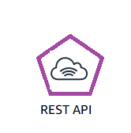

Using Amazon S3 Glacier
RESTful
web services
Java or .NET SDKs
Amazon S3 with lifecycle policies
Notes:
To store and access data in Amazon S3 Glacier, you can use the AWS Management Console. However, only a few operations—such as creating and deleting vaults, and creating and managing archive policies—are available in the console.
For almost all other operations and interactions with Amazon S3 Glacier, you must use either the Amazon S3 Glacier REST APIs, the AWS Java or .NET SDKs, or the AWS CLI.
You can also use lifecycle policies to archive data into Amazon S3 Glacier. Next, you will learn about lifecycle policies.

Slide 119
Lifecycle policies
Amazon S3 lifecycle policies enable you to delete or move objects based on age.
Amazon S3 Standard
Amazon S3 Standard - Infrequent Access
Amazon
S3 Glacier
Delete
30 days
60 days
365 days
Preview2.mp4
Preview2.mp4
Preview2.mp4
Notes:
You should automate the lifecycle of the data that you store in Amazon S3. By using lifecycle policies, you can cycle data at regular intervals between different Amazon S3 storage types. This automation reduces your overall cost, because you pay less for data as it becomes less important with time.
In addition to setting lifecycle rules per object, you can also set lifecycle rules per bucket.
Consider an example of a lifecycle policy that moves data as it ages from Amazon S3 Standard to Amazon S3 Standard – Infrequent Access, and finally, into Amazon S3 Glacier before it is deleted. Suppose that a user uploads a video to your application and your application generates a thumbnail preview of the video. This video preview is stored to Amazon S3 Standard, because it is likely that the user wants to access it right away.
Your usage data indicates that most thumbnail previews are not accessed after 30 days. Your lifecycle policy takes these previews and moves them to Amazon S3 – Infrequent Access after 30 days. After another 30 days elapse, the preview is unlikely to be accessed again. The preview is then moved to Amazon S3 Glacier, where it remains for 1 year. After 1 year, the preview is deleted. The important thing is that the lifecycle policy manages all this movement automatically.
To learn more, see Object lifecycle management

Slide 120
Storage comparison
 | Amazon S3 | Amazon S3 Glacier
Data Volume | No limit | No limit
Average Latency | ms | minutes/hours
Item Size | 5 TB maximum | 40 TB maximum
Cost/GB per Month | Higher cost | Lower cost
Billed Requests | PUT, COPY, POST, LIST, and GET | UPLOAD and retrieval
Retrieval Pricing | ¢ Per request | ¢¢ Per request and per GB
Notes:
While Amazon S3 and Amazon S3 Glacier are both object storage solutions that enable you to store a virtually unlimited amount of data, they have some critical differences between them. The chart outlines some of these differences.
Be careful when you decide which storage solution is correct for your needs. These two services serve very different storage needs. Amazon S3 is designed for frequent, low-latency access to your data, but Amazon S3 Glacier is designed for low-cost, long-term storage of infrequently accessed data.
The maximum item size in Amazon S3 is 5 TB, but Amazon S3 Glacier can store items that are up to 40 TB.
Because Amazon S3 gives you faster access to your data, the storage cost per gigabyte is higher than it is with Amazon S3 Glacier.
While both services have per-request charges, Amazon S3 charges for PUT, COPY, POST, LIST, GET operations. In contrast, Amazon S3 Glacier charges for UPLOAD and retrieval operations.
Because Amazon S3 Glacier was designed for less-frequent access to data, it costs more for each retrieval request than Amazon S3.

Slide 121






Server-side encryption
Corporate
data center
AWS Cloud
https
Your Applications on
Amazon EC2
Amazon EC2
AWS Cloud
Data is encrypted by default
Your application must enable server-side encryption
Amazon S3 Glacier
Amazon S3
Notes:
Another important difference between Amazon S3 and Amazon S3 Glacier is how data is encrypted. Server-side encryption is focused on protecting data at rest. With both solutions, you can securely transfer your data over HTTPS. Any data that is archived in Amazon S3 Glacier is encrypted by default. With Amazon S3, your application must initiate server-side encryption. You can accomplish server-side encryption in Amazon S3 in several ways:
Server-side encryption with Amazon S3-managed encryption keys (SSE-S3) employs strong multi-factor encryption. Amazon S3 encrypts each object with a unique key. As an additional safeguard, it encrypts the key with a master key that it regularly rotates. Amazon S3 server-side encryption uses one of the strongest block ciphers available, 256-bit Advanced Encryption Standard (AES-256), to encrypt your data.
Using server-side encryption with Customer-provided Encryption Keys (SSE-C) enables you to set your own encryption keys. You include the encryption key as part of your request, and Amazon S3 manages both encryption (as it writes to disks), and decryption (when you access your objects).
Using server-side encryption with AWS Key Management Service (AWS KMS) is a service that combines secure, highly available hardware and software to provide a key management system that is scaled for the cloud. AWS KMS uses Customer Master Keys (CMKs) to encrypt your Amazon S3 objects. You use AWS KMS through the Encryption Keys section in the IAM console. You can also access AWS KMS through the API to centrally create encryption keys, define the policies that control how keys can be used, and audit key usage to prove that they are being used correctly. You can use these keys to protect your data in Amazon S3 buckets.

Slide 122
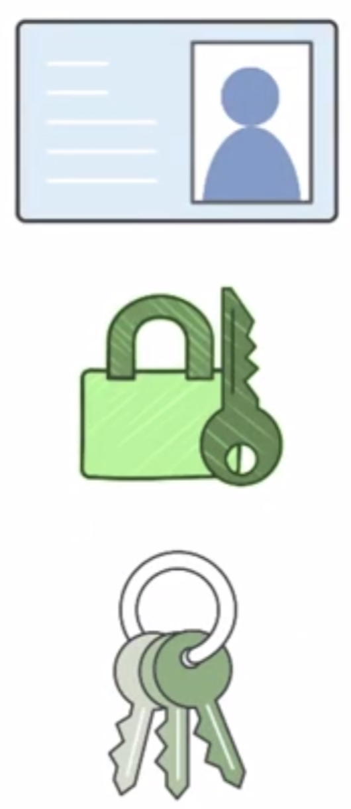
Security with Amazon S3 Glacier
Control access with IAM
Amazon S3 Glacier encrypts your data with AES-256
Amazon S3 Glacier
Amazon S3 Glacier manages your keys for you
Notes:
By default, only you can access your data. You can enable and control access to your data in Amazon S3 Glacier by using IAM. You set up an IAM policy that specifies user access.

Slide 123
Section 4 key takeaways
Amazon S3 Glacier is a data archiving service that is designed for security, durability, and an extremely low cost.
Amazon S3 Glacier pricing is based on Region.
Its extremely low-cost design works well for long-term archiving.
The service is designed to provide 11 9s of durability for objects.
123
Notes:
You have completed an introduction to Amazon S3 Glacier, which included key differences between Amazon S3 and Amazon S3 Glacier.
To learn more about Amazon S3 Glacier, see Glacier.
Glacier

Slide 124
Additional resources
AWS Storage page
Storage Overview
Recovering files from an Amazon EBS volume backup
Confused by AWS Storage Options? S3, EFS, EBS Explained
Notes:
If you want to learn more about the topics covered in this module, you might find the following additional resources helpful:
AWS Storage page
Storage Overview
Recovering files from an Amazon EBS volume backup
Confused by AWS Storage Options? S3, EFS, EBS Explained

Slide 125
Thank you
Notes:
Thanks for participating!

Slide 126
Part 3
Google Cloud Foundations Course: Module 4

Slide 127
Where Do I Store This Stuff?
Copyright Google LLC. For educational purposes in accordance with the terms of use set forth on the program Website.
Notes:
Welcome to Where Do I Store This Stuff?, I’m ______. In this module, we’ll look at how we can take advantage of managed storage and databases for cloud applications.

Slide 128
Course map
Module 1
Module 2
Module 3
Module 4
Module 5
So, What’s the Cloud Anyway?
Start with a Solid Platform
Use Google Cloud to Build Your Apps
Where Do I Store This Stuff?
There’s an API for That!
Module 6
Module 7
Module 8
Module 9
Module 10
You Can’t Secure the Cloud, Right?
It Helps to Network
Let Google Keep an Eye on Things
You Have the Data, but What Are You Doing with It?
Let Machines Do the Work
Google Cloud skills badges
Copyright Google LLC. For educational purposes in accordance with the terms of use set forth on the program Website.
128
Notes:
So far in this course, we’ve learned what Google Cloud is, found out why we should have a solid platform before beginning a Google Cloud transfer; and learned how Google Cloud supports the building of apps. In this module, we’ll find out everything we need to know about storage and database options in Google Cloud.

Slide 129
Agenda
Storage Options in the Cloud
Structured and Unstructured Storage in the Cloud
Unstructured Storage using Cloud Storage
SQL Managed Services
Copyright Google LLC. For educational purposes in accordance with the terms of use set forth on the program Website.
Notes:
Here’s the agenda for this module. We’ll begin by learning about different storage options in the cloud, which includes structured and unstructured storage. Next, we’ll learn how to leverage unstructured storage using Cloud.

Slide 130
Agenda
Storage Options in the Cloud
Structured and Unstructured Storage in the Cloud
Unstructured Storage using Cloud Storage
SQL Managed Services
Copyright Google LLC. For educational purposes in accordance with the terms of use set forth on the program Website.
Notes:
Let’s start with our first topic, which explores the different storage options that exist in the cloud.

Slide 131






Google Cloud has many storage options
Compute
Networking
Big data
Machine learning
Storage
Operations and tools
Relational databases
Non-relational databases
Data warehousing
Cloud
Storage
Cloud
SQL
Cloud
Spanner
Datastore
Cloud Bigtable
BigQuery
Copyright Google LLC. For educational purposes in accordance with the terms of use set forth on the program Website.
Notes:
Google Cloud offers many different storage options from object storage to database services. These options help users save costs, reduce the time it takes to launch, and make the most of their datasets by being able to analyze a wide variety of data.
All applications create and use data. Google provides all the tools needed to build and move applications to the cloud. This includes storing videos, images and other objects, even operational application data.
Applications, in many cases, require a storage solution and Google Cloud provides managed services that are scalable, reliable ,and easy to operate. For relational databases, which are commonly used today, Google offers a Cloud SQL for MySQL in Postgres, as well as Cloud Spanner. Google also have non-relational, or NoSQL databases like Datastore and Cloud Bigtable.
BigQuery is a highly scalable enterprise data warehouse, and falls outside of the storage solutions discussed in this module.

Slide 132
There are three common use cases for cloud storage
1
Content storage and delivery
Storage for data analytics and general compute
2
3
Backup and archival storage
Copyright Google LLC. For educational purposes in accordance with the terms of use set forth on the program Website.
Notes:
For cloud storage, there are three common use cases. The first is content storage and delivery. This is when users have content such as images or videos and they serve that content to end users wherever they are. People want their content fast, so running on the global network that Google provides makes for a great experience for end users.
The second use case is storage for data analytics and general compute. Users can process or expose their data to analytics tools like the analytics stack of products that Google Cloud offers and do things like genomic sequencing or IOT data analysis.
The third use case is backup and archival storage. Users can save storage costs by migrating infrequently accessed content to cheaper cloud storage options. Also, if anything happens to their data on-premises, it's critical to have a copy in the cloud for recovery purposes.

Slide 133

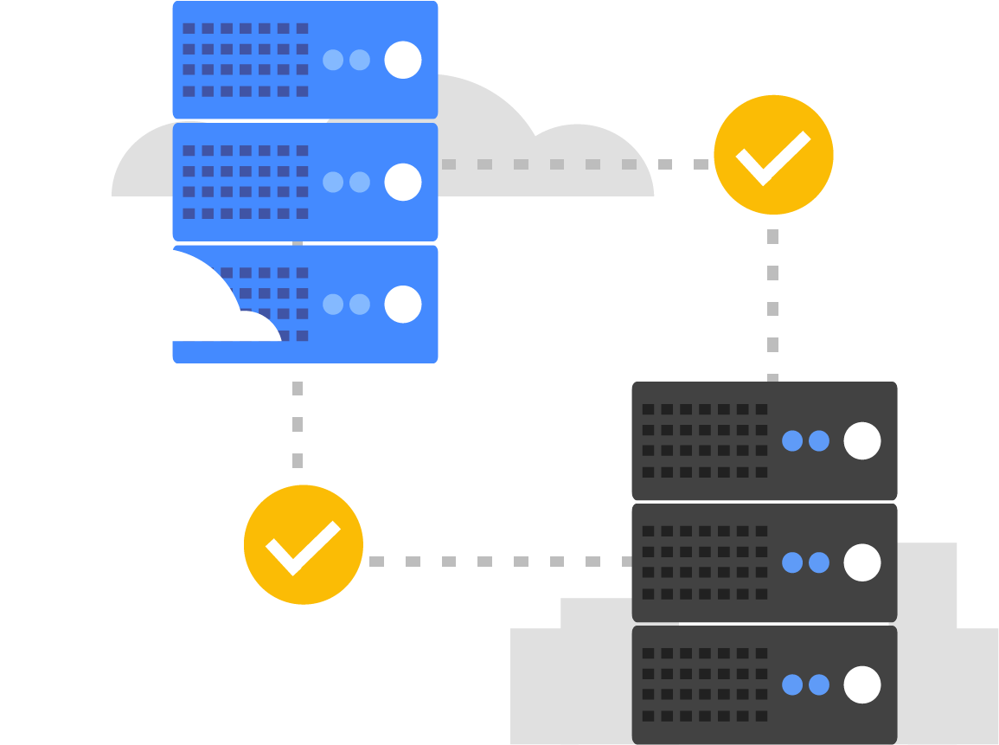
For users with databases, Google has two priorities
Migrate existing databases to the cloud, and move them to the right service.
Innovate, build, or rebuild for the cloud, take advantage of mobile, and plan for future growth.
Copyright Google LLC. For educational purposes in accordance with the terms of use set forth on the program Website.
Notes:
For users with databases, Google’s first priority is to help them migrate existing databases to the cloud and move them to the right service. This will usually be users moving MySQL or Postgres workloads to Cloud SQL. The second priority is to help users innovate, build or rebuild for the cloud, take advantage of mobile, and plan for future growth.

Slide 134
Agenda
Storage Options in the Cloud
Structured and Unstructured Storage in the Cloud
Unstructured Storage using Cloud Storage
SQL Managed Services
Copyright Google LLC. For educational purposes in accordance with the terms of use set forth on the program Website.
Notes:
Here’s the agenda for this module. We’ll begin by learning about different storage options in the cloud, which includes structured and unstructured storage. Next, we’ll learn how to leverage unstructured storage using Cloud.

Slide 135
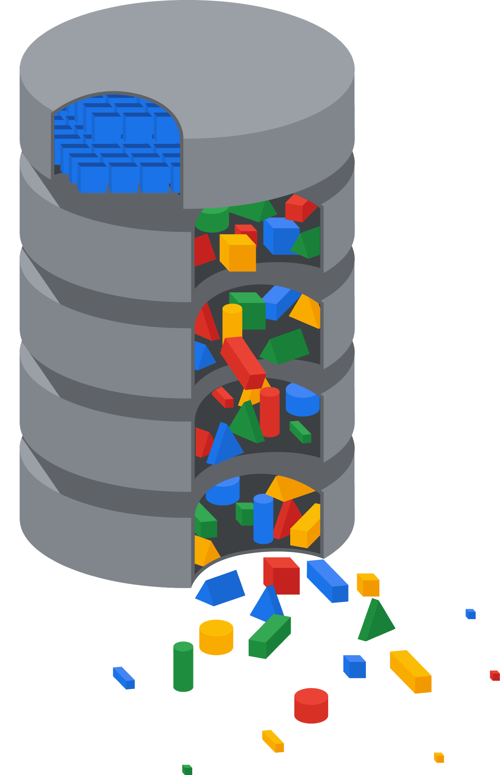
Structured versus unstructured data
Unstructured data
Transactions
First_Name | Last_Name | Address | City | Age
Sherlock | Holmes | 12 Main St | Mesa | 60
James | Bond | 23 Old St | Napa | 43
Scarlett | O’Hara | 34 New St | Derby | 23
Marge | Simpson | 56 West St | Cody | 36
Voice transcriptions
Online communities
Notes & text fields
Structured data
Ratings & reviews
Social media
Call center
Email
Chat
Surveys
Copyright Google LLC. For educational purposes in accordance with the terms of use set forth on the program Website.
Notes:
Structured data is what most people are used to working with and typically fits within columns and rows in spreadsheets or relational databases. You can expect this type of data to be organized and clearly defined, and usually easy to capture, access and analyze. Examples of structured data would include names, addresses, contact numbers, dates and billing info. The benefit of structured data is that it can be understood by programming languages and data can be manipulated relatively quickly.
It’s estimated that around 80 percent of all data is unstructured. It’s far more difficult to process or analyze unstructured data using traditional methods as there’s no internal identifier to enable search functions to identify it. Unstructured data often includes text and multimedia content, for example, e-mail messages, documents, photos, videos, presentations, webpages, and so on. Organizations are focusing increasingly on mining unstructured data for insights that will provide them with a competitive edge.

Slide 136
What type of storage will meet my needs best?
Is your data structured?
No
?
Yes
Cloud Storage
Is your workload analytics?
?
Yes
No
Do you need horizontal scalability?
Is your data relational?
Do you need updates or low latency?
?
Yes
?
?
No
Yes
No
Yes
No
Cloud SQL
Cloud Spanner
Datastore
Cloud Bigtable
BigQuery
Copyright Google LLC. For educational purposes in accordance with the terms of use set forth on the program Website.
Notes:
This flowchart shows the decision tree for determining, based on use case, which storage solution should be utilized. If you need a solution to hold files, backups, logs, and blobs for example, a good unstructured solution would be Cloud Storage.
If you need a structured solution, and are utilizing workload analytics, BigQuery and Cloud Bigtable are two options. If a relational database is needed, then you can choose either a traditional managed MySQL or Postgres database using Cloud SQL, or use a horizontally scalable, highly available database like Cloud Spanner.
If you need a simple NoSQL option to use for your application, Datastore is a solid choice.

Slide 137
Agenda
Storage Options in the Cloud
Structured and Unstructured Storage in the Cloud
Unstructured Storage using Cloud Storage
SQL Managed Services
Copyright Google LLC. For educational purposes in accordance with the terms of use set forth on the program Website.
Notes:
Here’s the agenda for this module. We’ll begin by learning about different storage options in the cloud, which includes structured and unstructured storage. Next, we’ll learn how to leverage unstructured storage using Cloud.

Slide 138
Cloud Storage in Google Cloud
Relational
Non-relational
Object
Warehouse
Cloud
SQL
Cloud
Spanner
Datastore
Cloud Bigtable
Cloud
Storage
BigQuery
Copyright Google LLC. For educational purposes in accordance with the terms of use set forth on the program Website.
Notes:
Cloud Storage is just one of many storage options on Google Cloud and stores and serves object data, also known as blob data.

Slide 139



Google uses Cloud Storage too!
Copyright Google LLC. For educational purposes in accordance with the terms of use set forth on the program Website.
Notes:
You can store an unlimited number of objects, up to 5 terabytes in size each, and Cloud Storage is well suited to binary or object data such as images, media serving, and backups.
Cloud Storage is the same storage that Google uses for images in Google Photos, Gmail attachments, Google Docs, and so on.

Slide 140
Cloud Storage offers different classes of storage
Storage Class | Minimum duration | Availability SLA | Typical monthly availability | Use cases | Name for APIs and gsutil
Standard Storage | None | Multi-region 99.95% Dual-region 99.95% Region 99.9% | >99.99% availability in multi-regions and dual-regions; 99.99% in regions | Access data frequently ("hot" data) and/or store for brief periods Serve website content Stream videos Interactive workloads Mobile and gaming apps | STANDARD
Nearline Storage | 30 days | Multi-region 99.9% Dual-region 99.9% Region 99.0% | 99.95% availability in multi-regions and dual-regions; 99.9% in regions | Read/modify data ≤ once per month Data backup Serve long-tail multimedia content | NEARLINE
Coldline Storage | 90 days |  |  | Read/modify data no more than once a quarter | COLDLINE
Archive Storage | 365 days | None |  | Read/modify data < once a year Cold data storage Disaster recovery | ARCHIVE
Copyright Google LLC. For educational purposes in accordance with the terms of use set forth on the program Website.
Notes:
Users have a variety of storage requirements for a multitude of use cases. Google offers different classes of Cloud Storage to cater for these requirements. The classes are based on how often data is accessed.
Standard Storage is best for data that is frequently accessed ("hot" data) and/or stored for only brief periods of time. When used in a region, co-locating your resources maximizes the performance for data-intensive computations and can reduce network charges. When used in a dual-region, you still get optimized performance when accessing Google Cloud products that are located in one of the associated regions, but you also get the improved availability that comes from storing data in geographically separate locations. When used in a multi-region, Standard Storage is appropriate for storing data that is accessed around the world, such as serving website content, streaming videos, executing interactive workloads, or serving data supporting mobile and gaming applications.
Nearline Storage is a low-cost, highly durable storage service for storing infrequently accessed data. Nearline Storage is a better choice than Standard Storage in scenarios where slightly lower availability, a 30-day minimum storage duration, and costs for data access are acceptable trade-offs for lowered at-rest storage costs. Nearline Storage is ideal for data you plan to read or modify on average once per month or less. Nearline Storage is appropriate for data backup, long-tail multimedia content, and data archiving.
Coldline Storage is a very-low-cost, highly durable storage service for storing infrequently accessed data. Coldline Storage is a better choice than Standard Storage or Nearline Storage in scenarios where slightly lower availability, a 90-day minimum storage duration, and higher costs for data access are acceptable trade-offs for lowered at-rest storage costs. Coldline Storage is ideal for data you plan to read or modify at most once a quarter.
Archive Storage is the lowest-cost, highly durable storage service for data archiving, online backup, and disaster recovery. Archive Storage has higher costs for data access and operations, as well as a 365-day minimum storage duration. Archive Storage is the best choice for data that you plan to access less than once a year. For example, cold data storage, such as data stored for legal or regulatory reasons, and disaster recovery.
Cloud Storage is unique in a number of ways, it has a single API, millisecond data access latency, and eleven 9s durability across all storage classes. Cloud Storage also offers object lifecycle management, which uses policies to automatically move data to lower cost storage classes as it is accessed less frequently throughout its life.
For more information, see: https://cloud.google.com/storage/docs/storage-classes

Slide 141
Cloud Storage Types
Nearline Storage is a low-cost, highly durable storage service for storing infrequently accessed data.
slightly lower availability, a 30-day minimum storage duration, and costs for data access are acceptable trade-offs for lowered at-rest storage costs.
Nearline Storage is ideal for data you plan to read or modify on average once per month or less.
Coldline Storage is a very-low-cost, highly durable storage service for storing infrequently accessed data.
Coldline Storage is a better choice than Standard Storage or Nearline Storage in scenarios where slightly lower availability, a 90-day minimum storage duration, and higher costs for data access are acceptable trade-offs for lowered at-rest storage costs.
Coldline Storage is ideal for data you plan to read or modify at most once a quarter.

Slide 142
Cloud Storage Types (continued)
Archive Storage is the lowest-cost, highly durable storage service for data archiving, online backup, and disaster recovery.
Archive Storage has higher costs for data access and operations, as well as a 365-day minimum storage duration.
Archive Storage is the best choice for data that you plan to access less than once a year.

Slide 143

Cloud Storage files are organized into buckets
Globally unique name
Location (region, dual-region, or multi-region)
Storage class
IAM policies or access-control lists
Object versioning setting
Object lifecycle management rules
Copyright Google LLC. For educational purposes in accordance with the terms of use set forth on the program Website.
Notes:
Cloud Storage files are organized into buckets. When you create a bucket, you give it a globally-unique name, you specify a geographic location where the bucket and its contents are stored, and you choose one of the default storage classes we just discussed.
There are several ways to control users’ access to your objects and buckets. For most purposes, Cloud IAM is sufficient. Roles are inherited from project to bucket to object. If you need finer control, you can create access control lists. ACLs define who has access to your buckets and objects, as well as what level of access they have. Each ACL consists of two pieces of information: A scope, which defines who can perform the specified actions and a permission, which defines what actions can be performed, for example, read or write.
You can turn on object versioning on your buckets if you want. If you do, Cloud Storage keeps a history of modifications--that is, overwrites or deletes--of all objects in the bucket. You can list the archived versions of an object, restore an object to an older state, or permanently delete a version, as needed. If you don’t turn on object versioning, new always overwrites old.
Cloud Storage also offers lifecycle management policies. For example, you could tell Cloud Storage to delete objects older than 365 days, or to delete objects created before January 1, 2013; or to keep only the 3 most recent versions of each object in a bucket that has versioning enabled.

Slide 144
Agenda
Storage Options in the Cloud
Structured and Unstructured Storage in the Cloud
Unstructured Storage using Cloud Storage
SQL Managed Services
Copyright Google LLC. For educational purposes in accordance with the terms of use set forth on the program Website.
Notes:
We’ll now complete a short activity based on Cloud Storage.

Slide 145
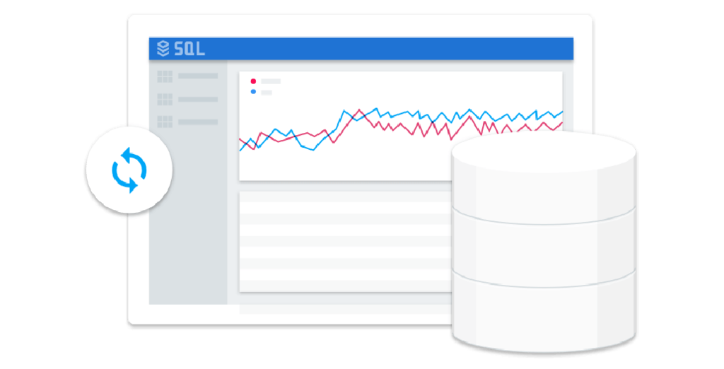
What is a database and how is it used?
A collection of information organized so that it can easily be accessed and managed.
Computer applications run databases to get a fast answer to questions.
Copyright Google LLC. For educational purposes in accordance with the terms of use set forth on the program Website.
Notes:
A database is a collection of information that is organized so that it can easily be accessed and managed. Users are building software applications using databases to answer business questions, such as buying a ticket, filing an expense report, storing a photo, or storing medical records. Computer applications run databases to get a fast answer to questions like:
What’s this user’s name given their sign-in information so I can display it?
What’s the cost of product Y so I can show it on my dynamic webpage?
What were my top 10 best selling products this month?
What is the next ad I should show the user currently browsing my site?
These apps must be able to write data in and read data out of databases. When a database is used, it’s usually run by a computer application. So when we say that “a database is useful for doing X,” it’s usually because it’s designed to make answering a question simply, fast, and efficient for the app.

Slide 146
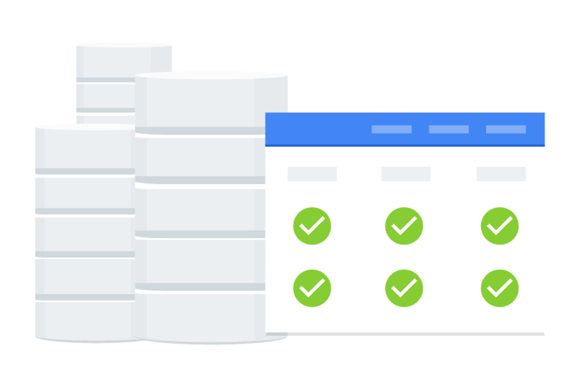
Relational databases are the most common
Relational database management systems
= RDBMS
= relational databases
= SQL databases
Suitable use cases:
Have a well-structured data model.
Need transactions.
Ability to join data across tables to retrieve complex data combinations.
Copyright Google LLC. For educational purposes in accordance with the terms of use set forth on the program Website.
Notes:
Relational database management systems, abbreviated RDBMS, or just relational databases, are used extensively and are the kind of database you encounter most of the time. They’re organized based on the relational model of data.
They are very good when you have a well-structured data model and when you need transactions and the ability to join data across tables to retrieve complex combinations of your data.
Because they make use of the Structured Query Language, they are sometimes called SQL databases.

Slide 147
Options for SQL-based managed services
Cloud SQL
MySQL, PostgreSQL, and SQL Server databases as a service
Automatic replication
Managed backups
Vertical scaling (read and write)
Horizontal scaling (read)
Cloud Spanner
Automatic replication
Strong global consistency
Managed instances with high availability
SQL (ANSI SQL 2011 with extensions)
Copyright Google LLC. For educational purposes in accordance with the terms of use set forth on the program Website.
Notes:
Google Cloud offers two managed relational database services. Cloud SQL offers managed MySQL, PostgresSQL, and SQL Server databases as a service. When setting up Cloud SQL with replicas, replication is automatic. The infrastructure of this database is managed. This will include backups, updates, failover, and maintenance. You are still responsible for user, schema, and data management. The database can scale horizontally for reads using read replicas, For writes you will have to make the database larger, which usually requires a reboot.
Cloud Spanner is a strongly consistent, horizontally scalable, managed relational database. This service can run your database across multiple nodes, either within a single region or to multiple regions. The managed service automatically replicates data to the nodes. Spanner is ANSI SQL 2011 compliant with extensions.

Slide 148
Cloud SQL in Google Cloud
Relational
Non-relational
Object
Warehouse
Cloud
SQL
Cloud
Spanner
Datastore
Cloud Bigtable
Cloud
Storage
BigQuery
Copyright Google LLC. For educational purposes in accordance with the terms of use set forth on the program Website.
Notes:
Cloud SQL is a fully managed, relational database service that makes it easy to set up, maintain, manage, and administer relational MySQL and PostgreSQL databases in the cloud. This allows you to focus on your applications. Cloud SQL is perfect for WordPress sites, ecommerce applications, CRM tools, geospatial applications, and any other application that is compatible with MySQL, PostgreSQL, or SQL Server.

Slide 149
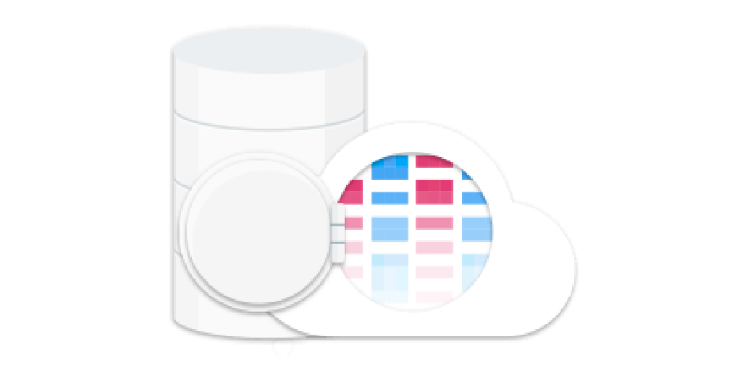

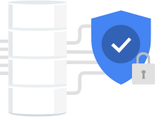

Cloud SQL helps manage mundane
administrative tasks
Fully managed
Performance and scalability
Reliability and security
Compatibility
No software installation.
Automated backups, replication, patches, and updates.
Scales to 64 processor cores and 400+ GB of RAM.
10 TB of storage.
High availability with automatic failovers.
Easily configure replication and backups.
Data is encrypted.
Accessible from almost any app.
Easy to move and migrate data.
Copyright Google LLC. For educational purposes in accordance with the terms of use set forth on the program Website.
Notes:
Cloud SQL doesn’t require any software installation and automates all backups, replication, patches, and updates. This is achieved with greater than 99.95% availability anywhere in the world.
To cater for workloads with different performance demands, Cloud SQL scales up to 64 processor cores and more than 400 GB of RAM per instance. Cloud SQL also provides you with up to 10 TB of storage capacity.
For isolation from failures, high availability provides continuous health-checking and automatically fails over if an instance isn’t healthy. You can also easily configure replication and backups to protect your data. Data is automatically encrypted and Cloud SQL meets applicable compliance requirements.
Cloud SQL instances are accessible from almost any application, anywhere. You can also easily connect from App Engine, Compute Engine, and your workstation. If your app works with MySQL or PostgreSQL, it’ll work with Cloud SQL. It's also easy to move and migrate data through built-in migration tools and standard connection drivers such as MySQL Workbench.

